Slide 1
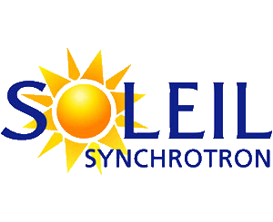


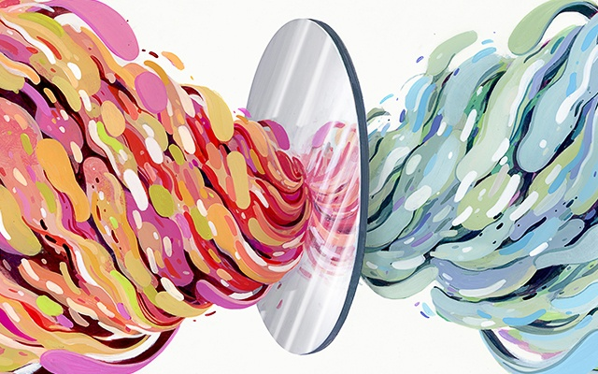
Asymmetric photolysis of chiral molecules of prebiotic importance at synchrotron SOLEIL
Iuliia Myrgorodska
CNRS UMR 7272 ICN
Université de Nice Sophia Antipolis
Thesis directors:
Prof. Uwe Meierhenrich (UNS)
Dr. Laurent Nahon (SOLEIL)
Exoatmo workshop
1/19

Slide 2
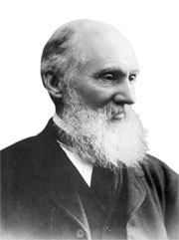
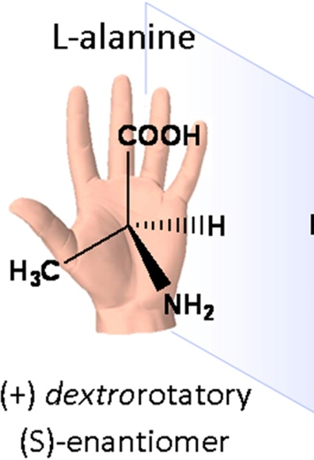
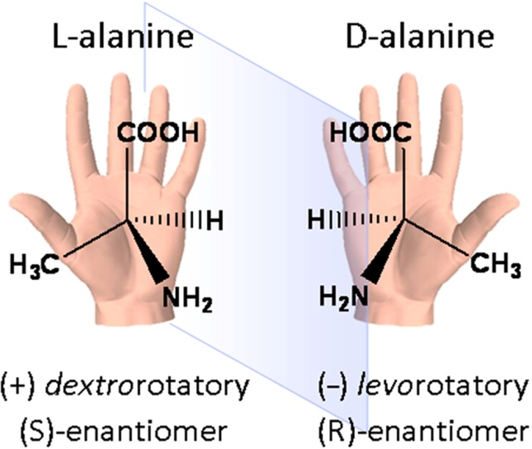
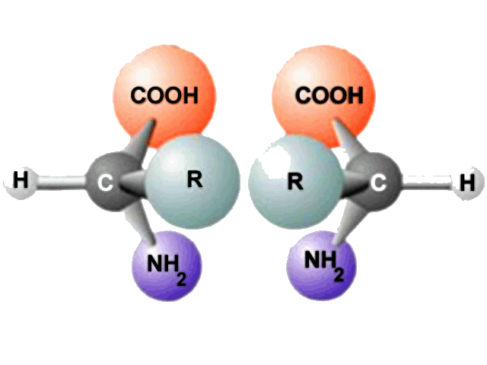
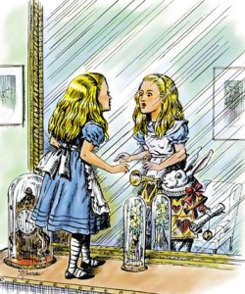
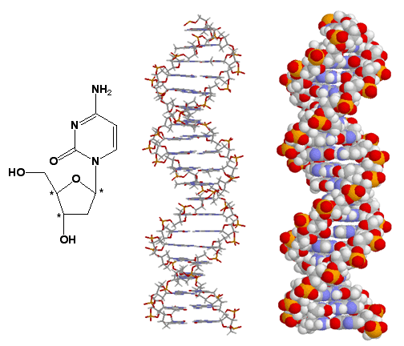
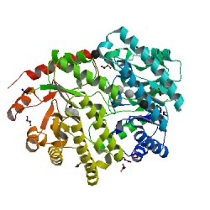
What is chirality?
Lord Kelvin, 1904
?
"I call any geometrical figure, or group of points, chiral, and say it has chirality, if its image in a plane mirror, ideally realized, cannot be brought to coincide with itself."
2/19

Slide 3

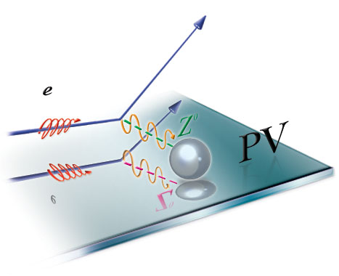
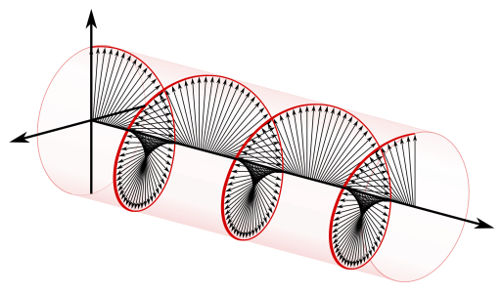
How it all started?
Origin of a chiral bias
Random process
“chance”
Determined process
“necessity”
Parity violation
Chiral fields
Evans A.C., C. Meinert, U.J. Meierhenrich et al., Chem. Soc. Rev. 41 (2012); 5447-5458:
3/19

Slide 4
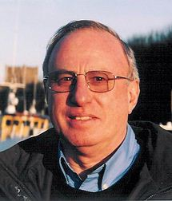
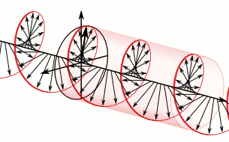
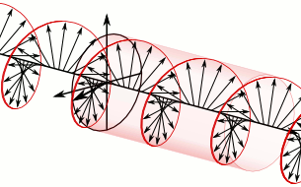
What is chirality?
Lord Kelvin, 1904
L.D. Barron
Rend. Fis. Acc. Lincei, 2013
Truly chiral system
=
Absolute enantioselection
True chirality is exhibited by systems that exist in two distinct enantiomeric states that are interconverted by space inversion (parity P), but not by time reversal (T) combined with any proper spatial rotation
"I call any geometrical figure, or group of points, chiral, and say it has chirality, if its image in a plane mirror, ideally realized, cannot be brought to coincide with itself."
time?
Left circularly polarized light
Right circularly polarized light
4/19

Slide 5
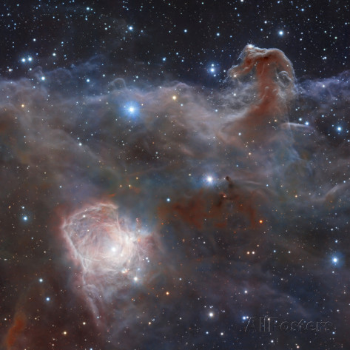
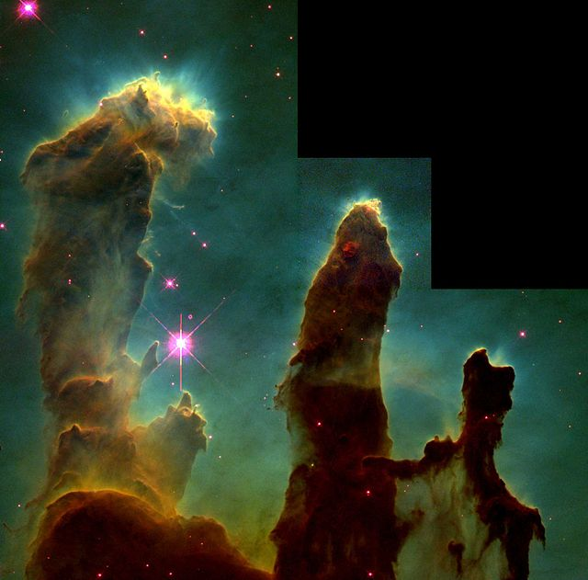
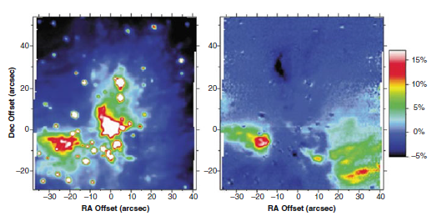
CPL in star formation region
Fig. 1 a) Star-forming Region NGC 2024 in the Constellation Orion b) Hubble telescope image known as Pillars of Creation, where stars are forming in the Eagle Nebula.
5/19

Slide 6
CPL in Orion star formation region
Fig. 2 Circular polarization (CP) map of the Orion Molecular Cloud-1 star formation region at 2.2 mm. Left: total infrared intensity of CP map of OMC-1. The typical size of the protostellar disk is much smaller than the observed structure of polarization. Right: percentage circular polarization at IR wavelength is observed to vary from 17% (dark region) to +5% (white region).
Bailey et al.: Science 281 (1998), 672-674.
6/19

Slide 7
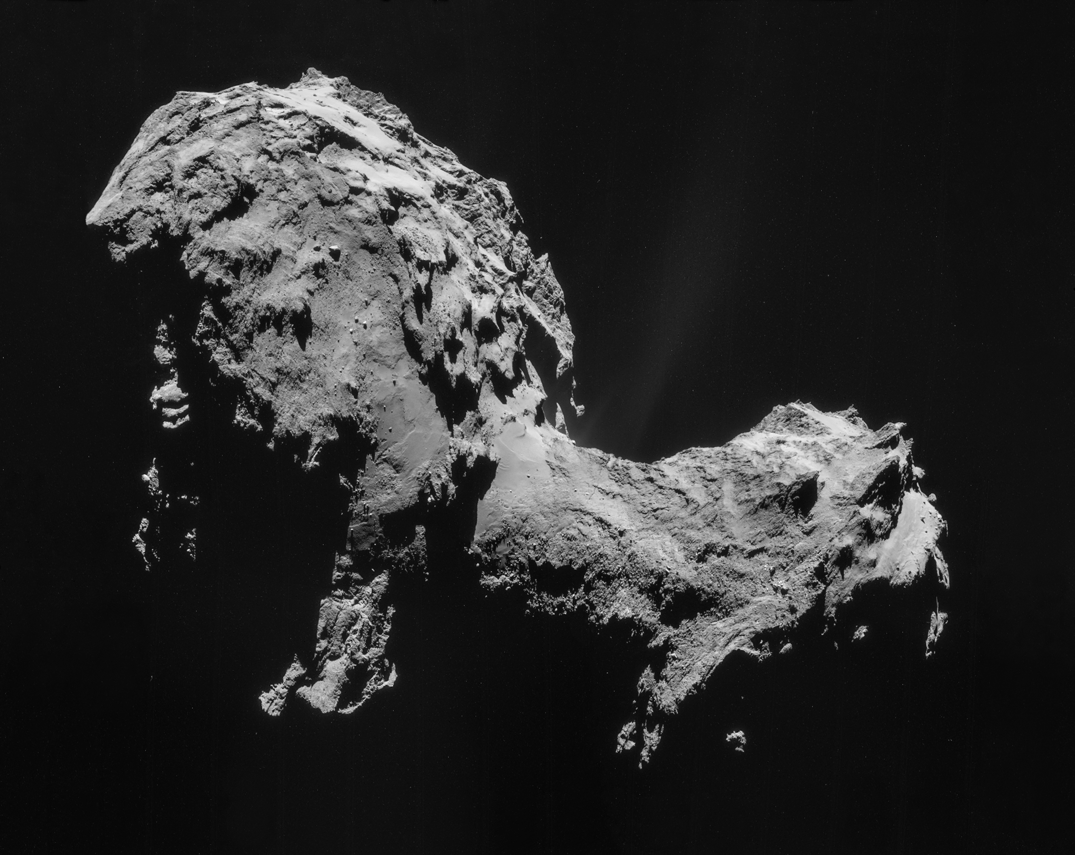
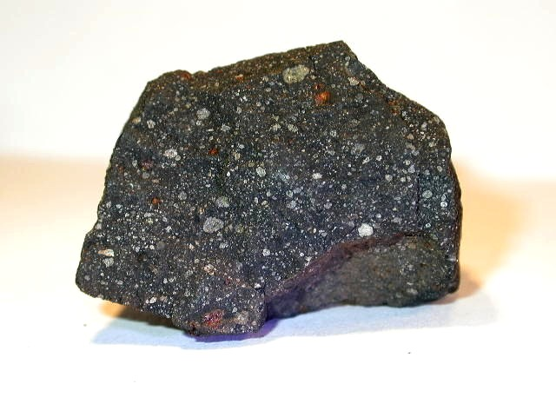
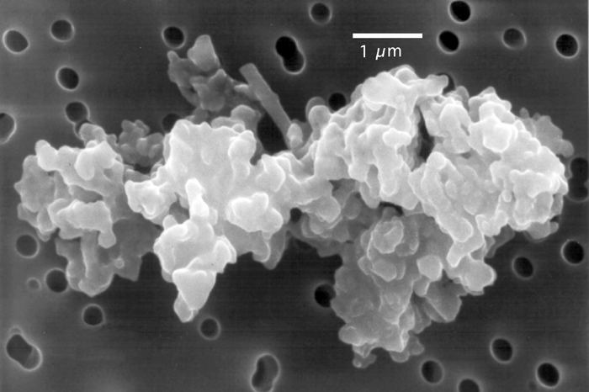
Interplanetary objects
Meteorites/Asteroids
Comets
Interplanetary dust particles
7/19

Slide 8
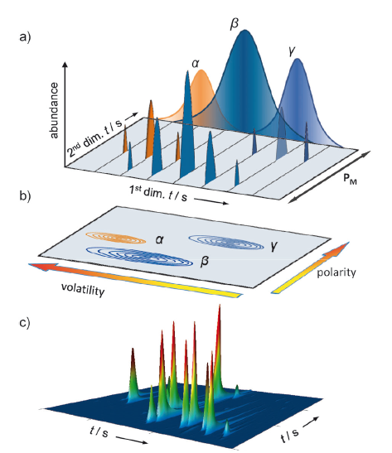
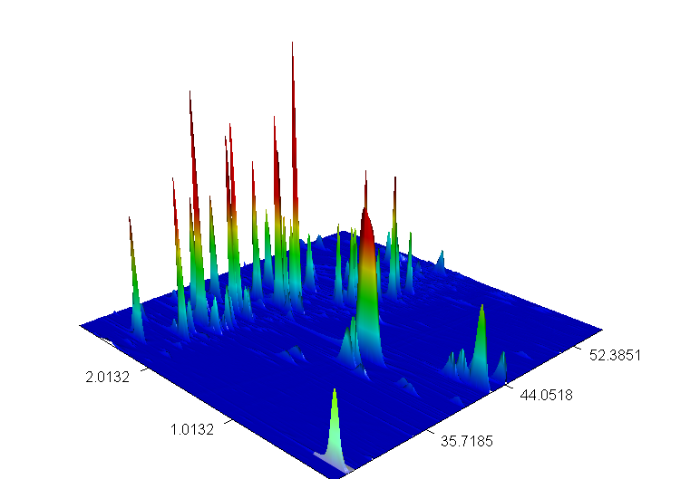
Comprehensive 2-D Gas chromatography
Fig.3 Illustration of a GCGC chromatogram.
a) Chromatographic peaks (a, b, and g) eluted from a typical apolar 1D column sequentially sliced into distinct fractions during a defined modulation period.
b) The data stream from the detector is then plotted based on the modulation in a 2D contour color plot
c) directly showing signal intensities in 3D presentation as conical peaks.
Meinert C., U. J. Meierhenrich Angew. Chem 51 (2012), 10460-10470.
8/19

Slide 9
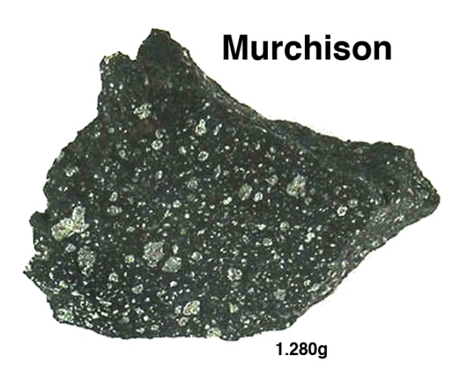
New identifications
Table 1. Amino acids identified in Murchison meteorite.
Group | #C | Compound
N-Alkylated amino acids | 3 | Sarcosine
 | 4 | N-Methylalanine
 | 4 | N-Ethylglycine
 | 4 | N-Methyl-β-alanine
 | 5 | N-Methyl-2-Aib
 | 5 | N-Methyl-2-Aba
 | 5 | N-Methyl-3-Aib
 | 5 | N-Methyl-3-Aia
 | 5 | N-Ethyl-β-alanine
 | 5 | N-Methyl-4-Aia
 | 5 | N-Methylaspartic acid
 | 6 | N-Methylisovaline
 | 6 | N-methylvaline
 | 7 | N-Methylisoleucine
 | 7 | N-Methyleucine
Iminodiacids | 4 | Iminodiacetic acid
 | 5 | Iminopropionic acetic acid
Fig.4 Close-up view of the 2D plot chromatogram depicting N-alkylated amino acids and homolog's.
8/9
C. Meinert, I. Myrgorodska, U. Meierhenrich et al., manuscript in preparation
9/19

Slide 10
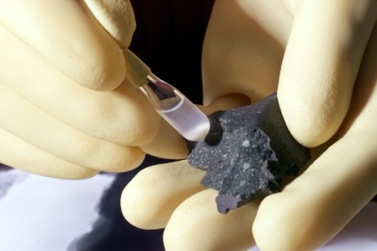
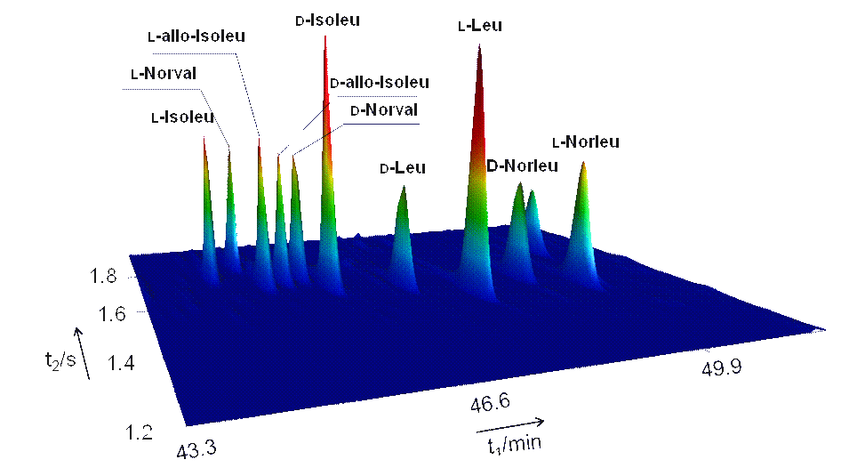
Enantiomeric enrichment in Murchison meteorite
Table 2. Enantiomeric excesses of amino acids in Murchison
CONTAMINATIONS ?
DERACEMIZATION ?
Amino acid | corrected ee_{L} (%) | R_{S}
Alanine | 3.16 ± 0.80 | 4.00
Aspartic acid | 4.31 ± 0.59 | 2.25
Valine | 4.88 ± 0.73 | 3.20
Glutamic acid | 3.79 ± 1.07 | 3.67
Pyroglutamic acid | 3.85 ± 0.78 | 3.20
Isoleucine | 9.49 ± 1.16 | 9.00
allo-Isoleucine | -9.55 ± 0.70 | 2.33
Leucine | 26.33 ± 0.76 | 4.75
Phenylalanine | 0.27 ± 3.32 | 4.00
Isovaline | 4.61 ± 0.83 | 1.67
Methylleucine | 6.16 ± 0.26 | 2.00
Norvaline | 0.55 ± 0.21 | 4.50
Norleucine | -0.04 ± 0.39 | 4.57
β-Leucine | -0.01 ± 0.45 | 4.50
tert-Leucine | 0.00 ± 0.23 | 5.50
3-Aminopentanoic acid | 0.52 ± 0.32 | 2.00
Methylpyroglutamic acid | 0.61 ± 0.03 | 3.60
2-Aminobutyric acid | 2.04 ± 0.86 | 3.80
3-Aminobutyric acid | 5.95 ± 0.62 | 1.43
Fig. 5 Close-up view of the two-dimensional enantioselective gas chromatogram depicting isoleucine, leucine, norvaline acids indentified in sample of the Murchison meteorite.
C. Meinert, I. Myrgorodska, U. Meierhenrich et al., manuscript in preparation
10/19

Slide 11
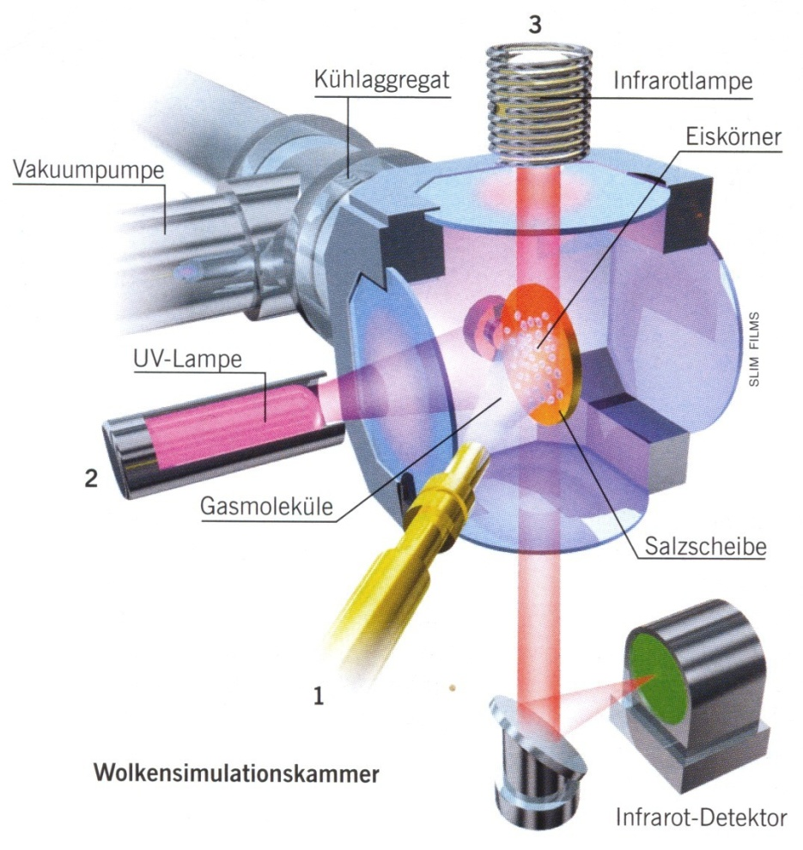
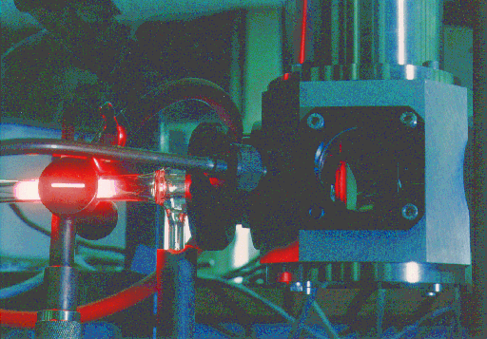
Laboratory simulation of interstellar ices
H₂O, CO, CO₂,
NH₃, CH₃OH
Fig.6b: Space simulation chamber at the Leiden Observatory. The ice sample (inset) is located inside the vacuum chamber at T = – 261°C and irradiated by energetic UV photons, hν = 10.2 eV. Matter remains after irradiation.
Fig.6a: Simulation chamber for interstellar particles. The ice sample composed of H₂O, CO, CO₂, NH₃, and CH₃OH is deposited 1 in the center on a MgF₂-window at a temperature of –261°C and irradiated by lamp producing energetic UV photons 2. n situ IR-spectra can be taken 3.
Muñoz Caro, Meierhenrich et al., Nature 416 (2002), 403-406.
11/19
Notes:
This situation recreates the irradiation of the ices that were present in the pre-solar nebula during the formation of the solar system. UV-irradiation of the ice leads to radical formation, radicals combine to form new molecules
Vacuum pressure of the gas line is 10⁻⁵ torr. CO₂ was kept in a separate bulb in order to prevent it from reacting with the ammonia.
Microwellen stimulierte Wasserstoff Entladungslampe 1.5 10¹⁵ photons/sec, gas flow 10¹⁶ molecules/sec
20 µm film thickness
The use of energy sources for prebiotic syntheses requires the activation of molecules in a local area, followed by quenching (löschen, abkühlen) of the activated mixture, and then protection of the synthesised organic compounds from further influence of the energy source. The quenching and protecting steps are critical because the organic compounds will be destroyed if they are subjected continuously to the energy source (Miller: in Brack, 1998)

Slide 12
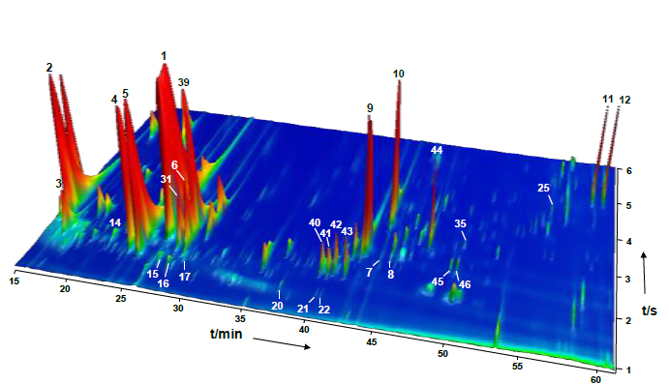
Amino acids in interstellar ice analogues
Fig. 7 Comprehensive two-dimensional enantioselective gas chromatogram depicting amino acids and diamino acids identified in simulated interstellar matter. Each point in the 3D chromatogram is accompanied by its individual mass spectrum. Atomic mass units 84, 88, 103, 117, 118, 130, 133, 146, 148, and 273 were selected for the above representation using a modulation time of P_{m} = 6 s.
C. Meinert, U.J. Meierhenrich et al., ChemPlusChem 77 (2012), 186-191.
12/19
Notes:
Dei ex machina
We were very puzzled, this raised a lot of questions.
Bisher dachte man, komplexe Moleküle können sich im Weltraum bei 10 K nicht bilden.
4 Aspekte auf die später einzeln eingegangen werden soll:
a) 6 Aminosäuren sind molekulare Bausteine der Proteine
b) Diaminosäuren sind molekulare Bausteine der PNA
c) Racemic occurrence, wie e.e. zu induzieren?
d) Pyrrole (und Furane) als molekulare Bausteine der Cofaktoren

Slide 13
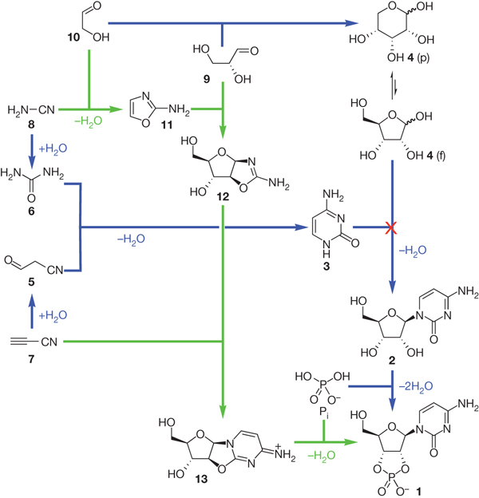
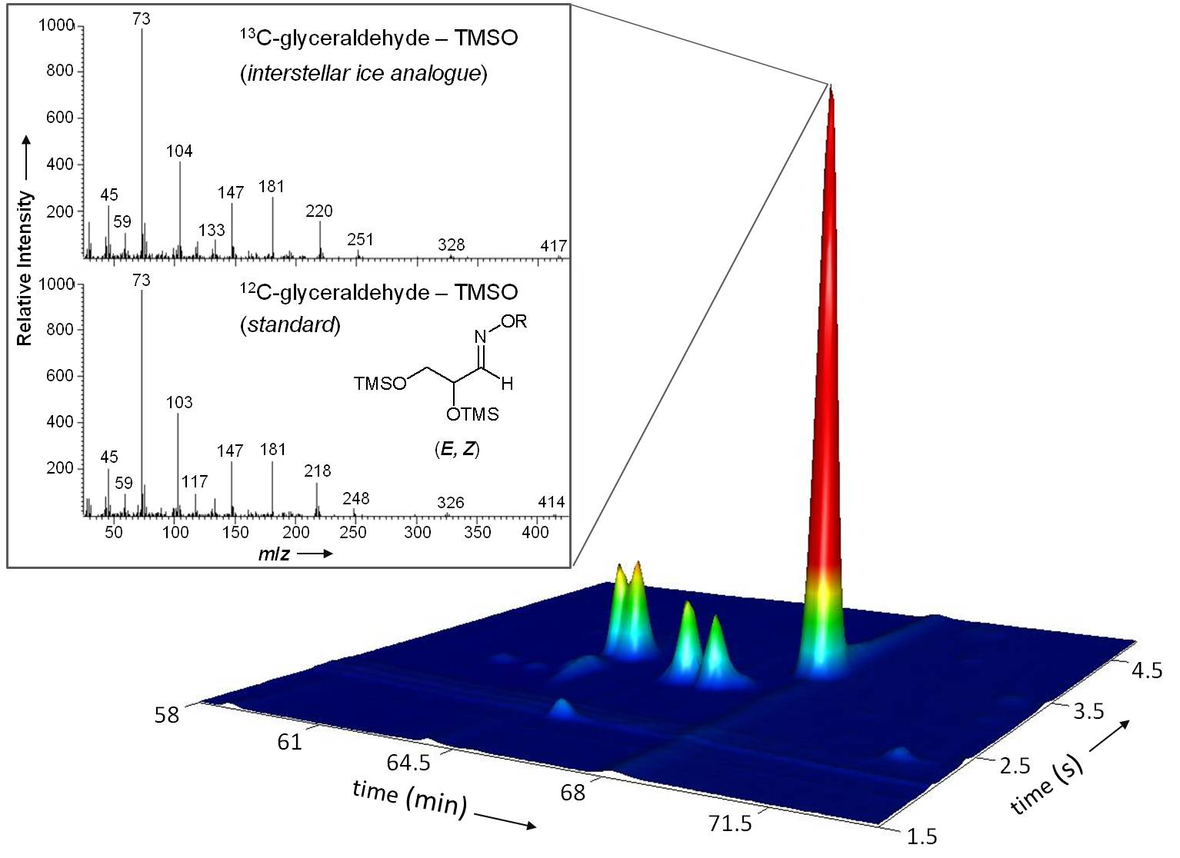
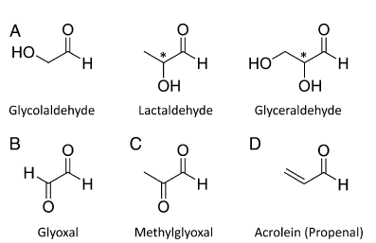
Aldehydes and sugars in interstellar ice analogues
Fig. 8a: Selected aldehydes identified at room temperature in simulated precometary organic residues: (A) hydroxyaldehydes, (B) dialdehyde, (C) ketoaldehyde, and (D) an unsaturated aldehyde.
Fig. 8: Glyceraldehyde detected in simulated precometary organic residues. Identification of glyceraldehyde as O-pentafluorobenzyl (R) oxime bis(trimethylsilyl) ether (PFBO-TMS) in laboratory organic residues using multidimensional
gas chromatography.
P. De Marcellus, C. Meinert, I. Myrgorodska et al., PNAS 112 (2015), 965-970.
M. W. Powner, B. Gerland, J.D. Sutherland Nature 459 (2009), 239-242.
13/19

Slide 14
Aldehydes and sugars in interstellar ice analogues
Fig. 9 Abundances of (A) aldehydes and (B) dialdehydes, keto- and hydroxyaldehydes in the room temperature samples with and without ammonia in the initial ice mixtures.
P. De Marcellus, C. Meinert, I. Myrgorodska et al., PNAS 112 (2015), 965-970.
14/19

Slide 15
Acids and polyols in interstellar ice analogues
Table 3. Acids and polyols in simulated interstellar ice analogues .
[a] Quantity of carbon atoms. [b] GC×GC retention time 1st dimension. [c] GC×GC retention time 2nd dimension. [d] R_{S} = 2(1t_{R,d}‒1t_{R,l})/(w_{d}+w_{l}), where 1t_{R,d} and 1t_{R,l} are retention times of the d- and l-enantiomers in the 1st dimension and w_{d} + w_{l} are their corresponding Gaussian curve width.
Manuscript in preparation
15/19

Slide 16
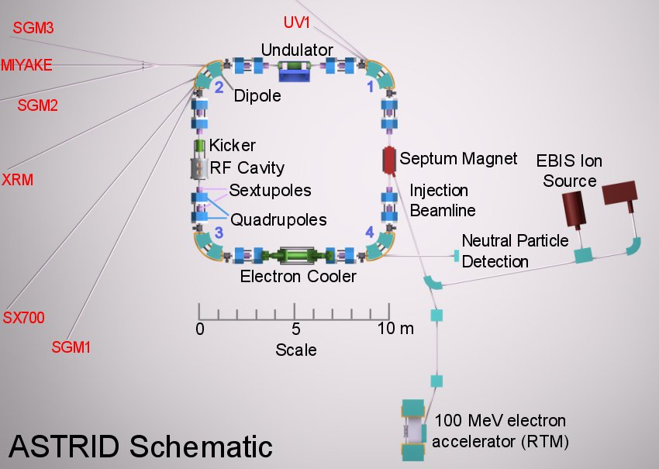

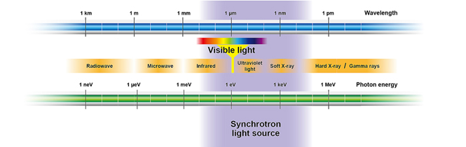
Synchrotron radiation
16/19

Slide 17
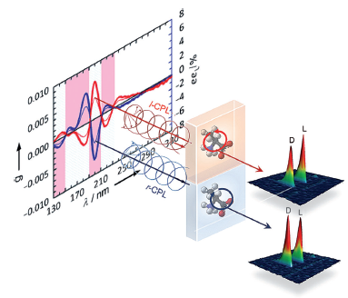
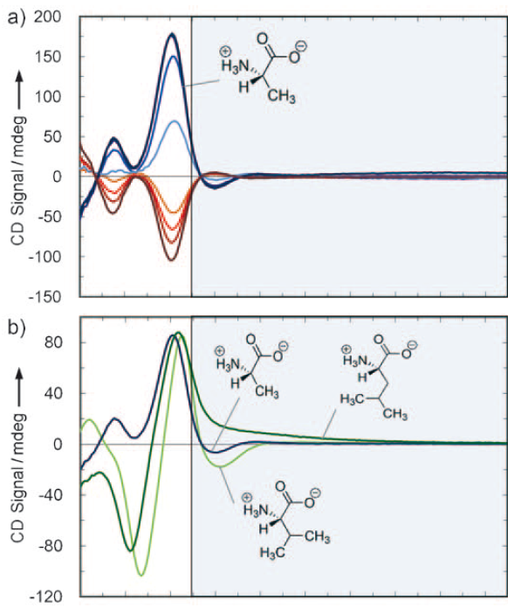

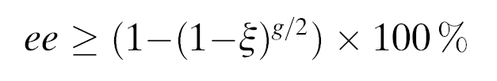
CD and anisotropy spectroscopy
Fig. 9 a: Vacuum ultra violet CD spectrum of amorphous solid-state alanine enantiomers.
Fig. 9 b: Photolytic induction of enantiomeric enrichment in racemic alanine. Interaction with CPL of sufficient energy imparts a slight bias for the less photoabsorbent enantiomer as the more photoabsorbent enantiomer undergoes faster photolysis. The degree and sign of the induced asymmetry depend on the helicity of the CPL, the energy of the driving electromagnetic radiation, the photolysis rate, and the anisotropy.
I. Myrgorodska, C. Meinert, U.J. Meierhenrich et al., Angew Chem Int Ed 54 (2015), 1402-1412.
C. Meinert, U.J. Meierhenrich et al., Angew Chem Int Ed 53 (2014), 210-214
17/19

Slide 18
What is yet to come?
CD and anisotropy spectra of chiral acids, aldehydes (November 2015, ISA)
CPL induced enantiomeric excess within prebioticaly relevant chiral molecules (February 2016, SOLEIL)
CPL induced enantiomeric excess within simulated interstellar ice analogues
COSAC experiment on the Rosetta mission?
18/19

Slide 19






Acknowledgments
Peoples:
Funding agencies:
University of Nice Sophia Antipolis, France
U.J. Meierhenrich, C. Meinert
Synchrotron SOLEIL, France
L. Nahon , A. Guillani
Institut d‘Astrophysique Spatiale, France
L. d‘Hendecourt
Istitute for Storage Ring Facilities, Denmark
S. V. Hoffmann, N. Jones
Thank you
for your attention
19/19

