Slide 2
Thermodynamics, Disequilibrium, Evolution (TDE) Focus Group NASA Astrobiology Institute (NAI)
Co-Chairs:
Eugenio Simoncini (INAF-Arcetri)
Laurie Barge (JPL)*
*standing in:
Kirt Robinson (ASU)

Slide 3
Thermodynamics, Disequilibrium and Evolution (TDE)
Introduction:
The TDE Focus Group concentrates on understanding the fundamental character of life - that it depends upon disequilibrium in the environment as a source of energy, that it maintains a state of disequilibrium as a condition of life, and that it can mark its existence in an environment through the presence of disequilibrium. The TDE-FG seeks to integrate the astrobiology community around this paradigm to inform our search for life in the universe.
The transdisciplinary questions we address include:
Under what energetic conditions does life start?
What are the thermodynamic requirements of its processes?
In which environments is it likely to exist?
How might we find it?
Notes:
How might we find it? That last point is important for the NAI’s support, because NASA is dominantly a mission oriented organization, so it’s always good to keep in mind how our results might drive various missions, what locations should spacecraft go to, what instruments need to be on a spacecraft and what kind of measurements need to be taken on what kind of samples in order to increase the chances of success to characterize habitability… etc…

Slide 4
Thermodynamics, Disequilibrium and Evolution (TDE)
TDE Activities:
Maintaining an e-mail distribution list. (New members sign up!)
Hosting a series of workshops to be held at astrobiology- and planetary-science-related institutes around the world. Workshops may be general or focused on TDE sub-topics of interest.
Organizing focused scientific sessions concerning the objectives of the focus group at larger conferences such as AbSciCon, AAS, and AGU.
Inspiring new research collaborations between TDE participants and developing these into viable products such as workshops, grant proposals, and published papers.
Developing strong international connections between researchers at astrobiology / origin-of-life institutions and organizations to support long-term collaborative research efforts.
Notes:
List being or will be passed around for anyone to sign up. Open membership – means anyone can join and is encouraged to do so! Hosting… one thing we will discuss later in the week is ideas for funding to be able to keep these meetings happening and to be able to keep bringing in early career scientists. Inspiring new research… Developing strong connections… mention Friday discussion will be all about this, so try to be thinking throughout the week about potential collaborations.

Slide 5
Visit our website:
https://astrobiology.nasa.gov/focus-groups/current/thermodynamics-disequilibrium-and-evolution-tde/

Slide 6
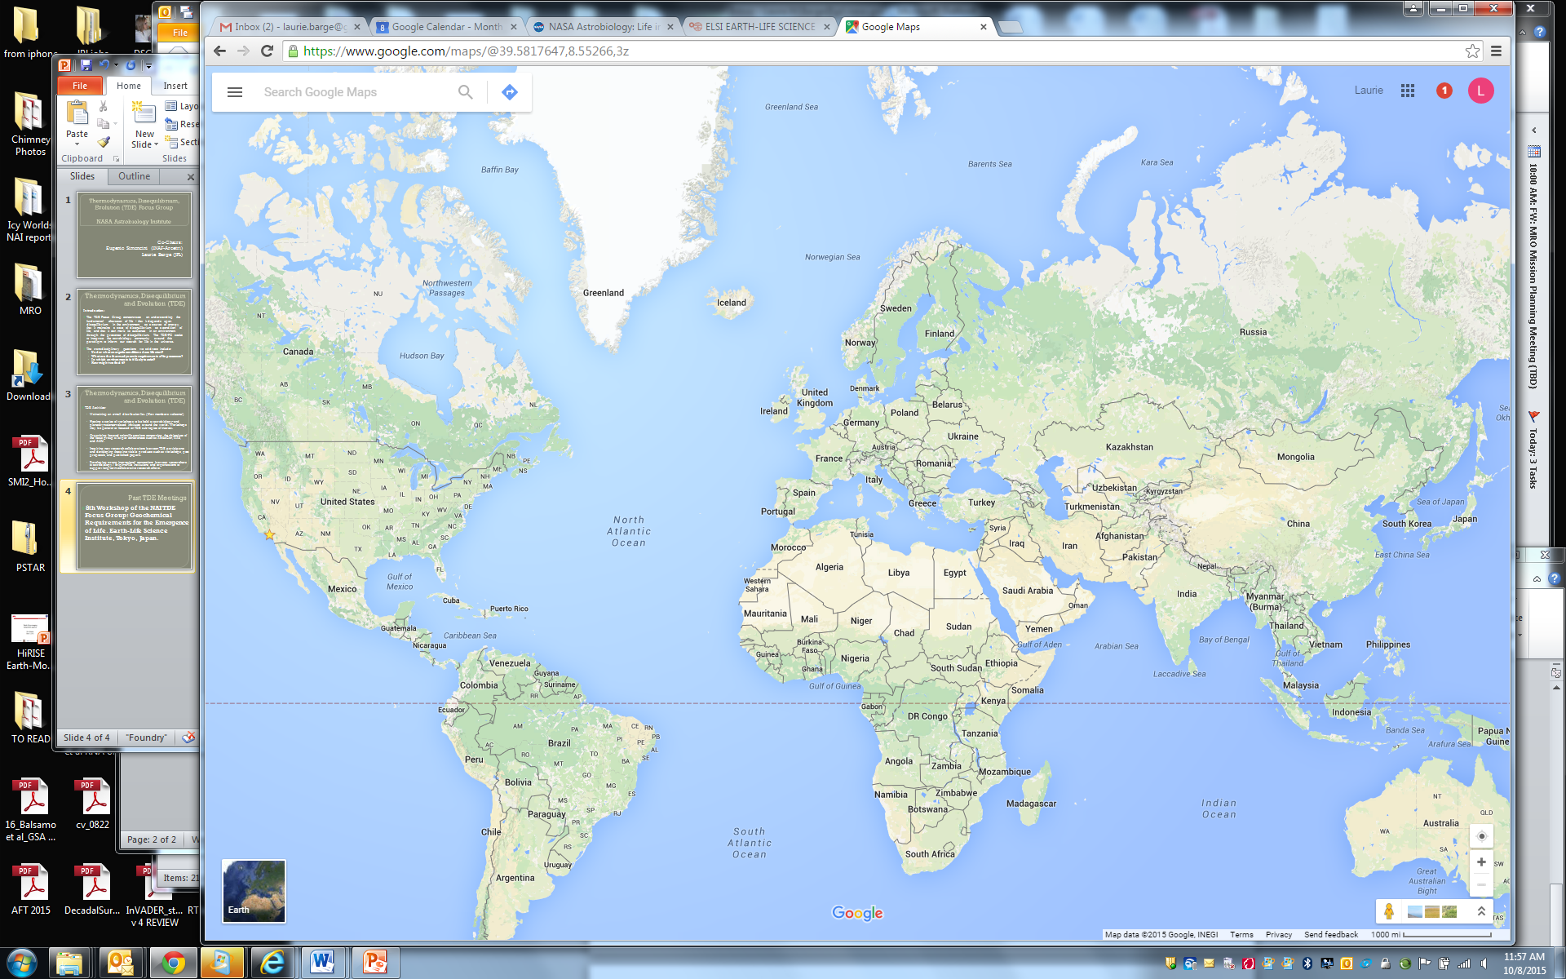
TDE Meetings
2013: Beyond Center and 5th TDE FG Workshop: “Engines of Life: thermodynamic pathways to metabolism”, Phoenix, USA
2015: TDE FG Workshop, “Exoplanetary Atmospheres and Habitability”, Observatory of Côte d'Azur
2014: 8th TDE FG Workshop: “Geochemical Requirements for the Emergence of Life”, Earth-Life Science Institute, Tokyo
2012: 3rd TDE FG Discussion meeting: AbSciCon, Atlanta, USA
2012: 4th TDE FG Workshop: Granada, Spain
2011: 1st TDE FG Workshop Madrid, Spain
2013: 6th TDE FG Workshop: “Out-of-Equilibrium Systems and Planetary Habitability”,
2011: 2nd TDE FG Workshop Florence, Italy
2014: 7th TDE FG Workshop, Campinas, Brazil.

Slide 7
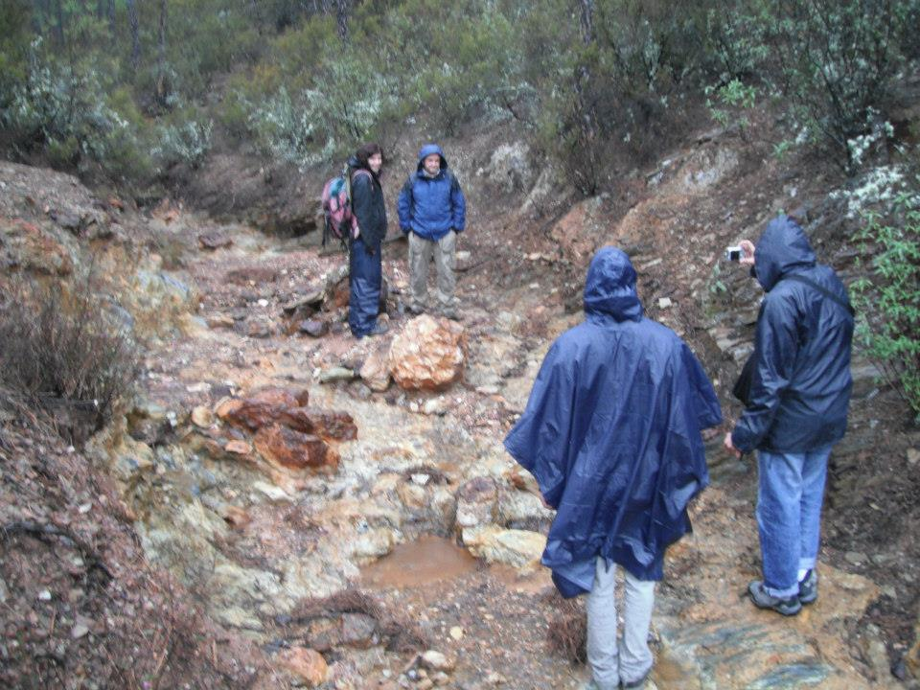
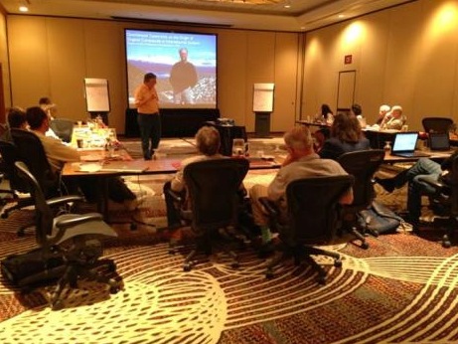
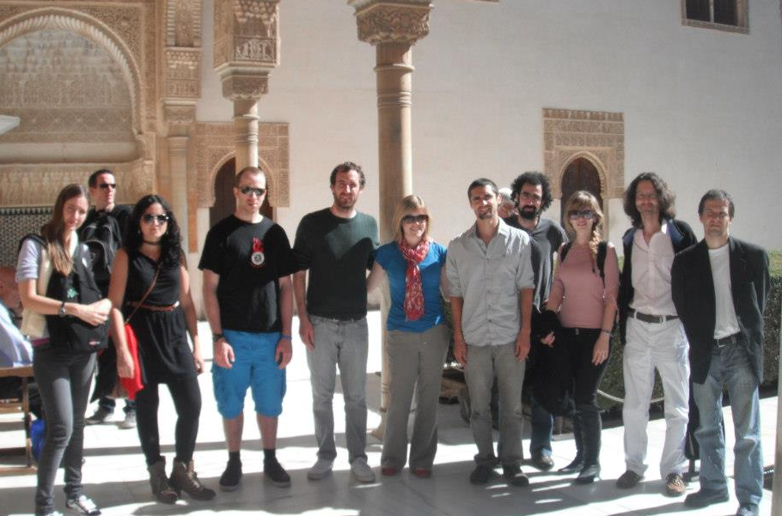
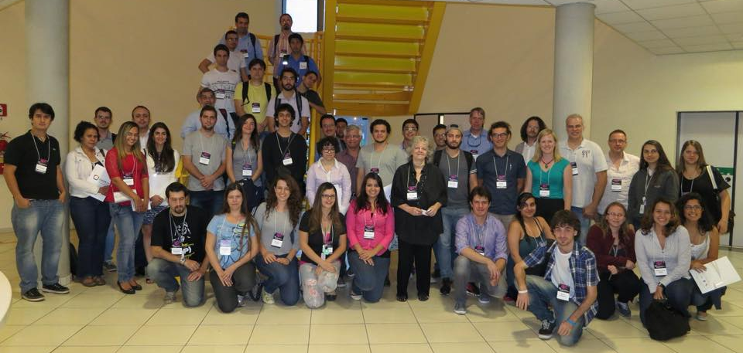
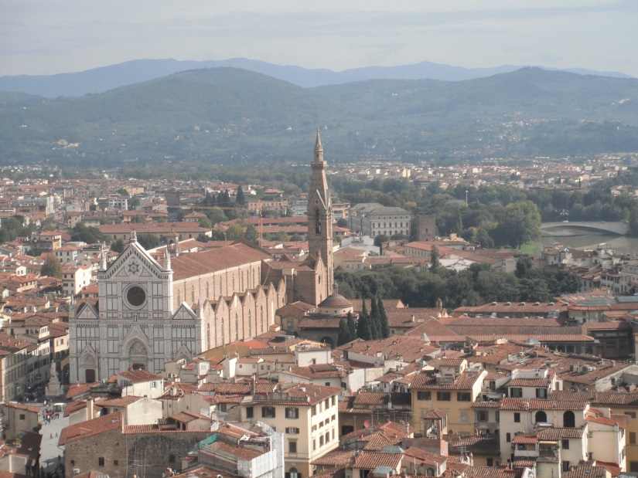
TDE FG Activities
Field trip, Rio Tinto (Spain, 2012)
Phoenix, Arizona (2013)
Granada, Spain (2012)
Florence, Italy (2013)
Campinas, Brazil (2014)

Slide 8
TDE FG Publications
In prep:
TDE White Paper : ”Thermodynamics, Disequilibrium, Evolution: Far-from-equilibrium Geological and Chemical Considerations for the Origin of Life “ Barge L. M., Branscomb, E., Cardoso, S., Cartwright, J., Danielache, S. O., Galante, D., Kee, T. P., Miguel, Y., Mojzsis, S., Robinson, K., Russell, M. J., Simoncini, E.
Published:
L. M. Barge, Y. Abedian, M. J. Russell, I. J. Doloboff, J. H. E. Cartwright, R. D. Kidd, I. Kanik. (2015) From Chemical Gardens to Fuel Cells: Generation of Electrical Potential and Current Across Self-Assembling Iron Mineral Membranes. Angew. Chemi. International Edition, 54, 28:8184-8187, DOI: 10.1002/anie.201501663.
L. M. Barge, S. S. S. Cardoso, J. H. E. Cartwright, G. J. T. Cooper, L. Cronin, A. De Wit, I. J. Doloboff, B. Escribano, R. E. Goldstein, F. Haudin, D. E. H. Jones, A. L. Mackay, J. Maselko, J. J. Pagano, J. Pantaleone, M. J. Russell, C. I. Sainz-Díaz, O. Steinbock, D. A. Stone, Y. Tanimoto, N. L. Thomas. (2015) From Chemical Gardens to Chemobrionics. Chemical Reviews, DOI: 10.1021/acs.chemrev.5b00014.
L. M. Barge, et al. (2015) Chemical Gardens as Flow-Through Reactors Simulating Natural Hydrothermal Systems. Journal of Visualized Experiments, in press.
Russell, M. J., Barge, L. M., Bhartia, R., Bocanegra, D., Bracher, P., Branscomb, E., Kidd, R., McGlynn, S., Meier, D., Nitschke, W., Shibuya, T., Vance, S., White, L. (2014) The Drive to Life on Rocky and Icy Worlds. Astrobiology,14, 4, 308-343.
Cardoso SSS, Cartwright JHE. (2014) Dynamics of osmosis in a porous medium. R. Soc. open sci. 1: 140352. http://dx.doi.org/10.1098/rsos.140352
L. M. Barge, T. P. Kee, I. J. Doloboff, J. M. P. Hampton, M. Ismail, M. Pourkashanian, J. Zeytounian, M. M. Baum, J. Moss, C.-K. Lin, R. D. Kidd, I. Kanik (2014) The Fuel Cell Model of Abiogenesis: A New Approach to Origin-of-Life Simulations. Astrobiology, 14(3):254-70.
Barge, L. M., et a., I. (2014) Pyrophosphate Synthesis in Iron Mineral Films and Membranes Simulating Prebiotic Submarine Hydrothermal Systems. GCA 128, 1-12.
Elbert Branscomb, Michael J. Russell. Turnstiles and bifurcators: The disequilibrium converting engines that put metabolism on the road. Biochimica et Biophysica Acta (BBA) – Bioenergetics. 2013 1827 (6): 806. doi:10.1016/j.bbabio.2012.10.003.
Julyan H. E. Cartwright, et al.(2013) Brinicles as a Case of Inverse Chemical Gardens. Langmuir 2013 29 (25), 7655-7660, DOI: 10.1021/la4009703
Simoncini, E., Virgo, N., Kleidon, A., Quantifying drivers of chemical disequilibrium: theory and application to methane in the Earth's atmosphere, Earth Syst. Dynam., 4, 317-331, 2013. doi:10.5194/esd-4-317-2013.
T. Grassi, S. Bovino, D. R. G. Schleicher, D. Seifried, J. Prieto, E. Simoncini, F. A. Gianturco, KROME - a package to easily embed the chemistry in astrophysical simulations. MNRAS, vol. 439, 3, 2386 - 2419.
Russell, M.J., Nitschke, W. & Branscomb, E. 2013, The inevitable journey to being. Phil. Trans. R. Soc. Lond. B 368: 20120254.

Slide 9
General Outline of Program:
Monday-Wednesday morning:
talks and short discussions
Wednesday afternoon:
observatory banquet and visit (free time)
Thursday: talks, end with longer discussion
Finish: final talks, end with collaborative discussion

Slide 10
General Outline of Program:
Icy moons, icy planets and the conditions for the emergence of life
The modeling and observations of exoplanetary atmospheres: chemistry and physics
The chemical disequilibrium in planetary atmospheres: from hot Jupiters to habitable planets

Slide 11
TDE FG Discussion this week
Friday, October 16th afternoon session: TDE General Discussion (Eugenio Simoncini, Kirt Robinson)
New members welcome!
Agenda:
New collaboration ideas
Progress on current collaborations
Planned publications, proposals
Brainstorm funding / locations for future TDE workshops!

