Slide 1
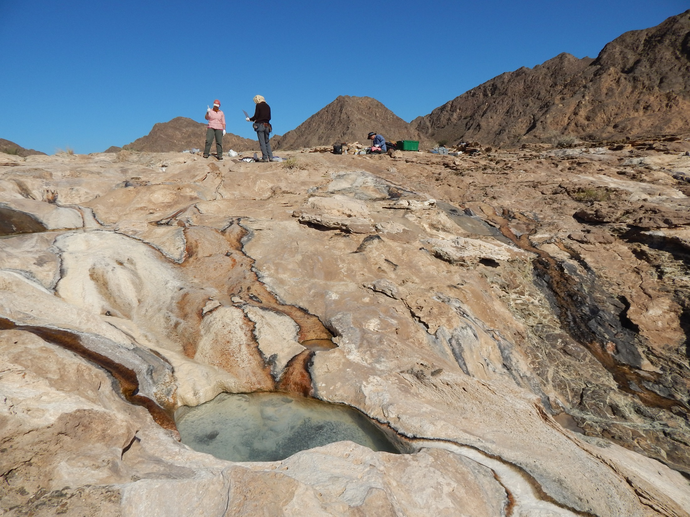
Abiotic Organic Synthesis
during Low Temperature Serpentinization
Kirtland J. Robinson and Everett L. Shock
TDE Exoatmo: October 13th, 2015
Notes:
Thank you. Title. I’d like to start mentioning how I perceive this to be relevant to “Exoplanetary Atmospheres and Habitability” in three areas: Habitability/Emeregence of Life: abiotic organic synthesis, Atmospheres: methane generation, Icy worlds: rocky interiors with serpentinization potential
And I like to demonstrate that we can get information about where organic acids were produced in the system based on surface analyses, and this is because the data we have collected from the system in Oman, that you can see pictured here, has yielded evidence that supports a link between organic acid production and specific carbonate minerals! In this picture, there are chocolate brown mountains in the background which are ultramafic rocks, and in the foreground is a large travertine apron that sits on the surface, which is dominantly calcium carbonate which has precipitated from these hyperalkaline springs interacting with the atmosphere. So how do we get organic acids from this system?

Slide 2
Abiotic Organic Synthesis
during Low Temperature Serpentinization
Emergence of life/Habitability: redox disequilibrium
Kirtland J. Robinson and Everett L. Shock
TDE Exoatmo: October 13th, 2015
Notes:
Thank you. Title. I’d like to start mentioning how I perceive this to be relevant to “Exoplanetary Atmospheres and Habitability” in three areas: Habitability/Emeregence of Life: abiotic organic synthesis, Atmospheres: methane generation, Icy worlds: rocky interiors with serpentinization potential
And I like to demonstrate that we can get information about where organic acids were produced in the system based on surface analyses, and this is because the data we have collected from the system in Oman, that you can see pictured here, has yielded evidence that supports a link between organic acid production and specific carbonate minerals! In this picture, there are chocolate brown mountains in the background which are ultramafic rocks, and in the foreground is a large travertine apron that sits on the surface, which is dominantly calcium carbonate which has precipitated from these hyperalkaline springs interacting with the atmosphere. So how do we get organic acids from this system?

Slide 3
Abiotic Organic Synthesis
during Low Temperature Serpentinization
Emergence of life/Habitability: redox disequilibrium
Atmospheres: methane generation
Kirtland J. Robinson and Everett L. Shock
TDE Exoatmo: October 13th, 2015
Notes:
Thank you. Title. I’d like to start mentioning how I perceive this to be relevant to “Exoplanetary Atmospheres and Habitability” in three areas: Habitability/Emeregence of Life: abiotic organic synthesis, Atmospheres: methane generation, Icy worlds: rocky interiors with serpentinization potential
And I like to demonstrate that we can get information about where organic acids were produced in the system based on surface analyses, and this is because the data we have collected from the system in Oman, that you can see pictured here, has yielded evidence that supports a link between organic acid production and specific carbonate minerals! In this picture, there are chocolate brown mountains in the background which are ultramafic rocks, and in the foreground is a large travertine apron that sits on the surface, which is dominantly calcium carbonate which has precipitated from these hyperalkaline springs interacting with the atmosphere. So how do we get organic acids from this system?

Slide 4
Abiotic Organic Synthesis
during Low Temperature Serpentinization
Emergence of life/Habitability: redox disequilibrium
Atmospheres: methane generation
Icy worlds: rocky interiors
Kirtland J. Robinson and Everett L. Shock
TDE Exoatmo: October 13th, 2015
Notes:
Thank you. Title. I’d like to start mentioning how I perceive this to be relevant to “Exoplanetary Atmospheres and Habitability” in three areas: Habitability/Emeregence of Life: abiotic organic synthesis, Atmospheres: methane generation, Icy worlds: rocky interiors with serpentinization potential
And I like to demonstrate that we can get information about where organic acids were produced in the system based on surface analyses, and this is because the data we have collected from the system in Oman, that you can see pictured here, has yielded evidence that supports a link between organic acid production and specific carbonate minerals! In this picture, there are chocolate brown mountains in the background which are ultramafic rocks, and in the foreground is a large travertine apron that sits on the surface, which is dominantly calcium carbonate which has precipitated from these hyperalkaline springs interacting with the atmosphere. So how do we get organic acids from this system?

Slide 5
Abiotic Organic Synthesis
during Low Temperature Serpentinization
Focus on formate, acetate, and methane
Kirtland J. Robinson and Everett L. Shock
TDE Exoatmo: October 13th, 2015
Notes:
Relevance to “Exoplanetary Atmospheres and Habitability” in three areas: Emergence of life/Habitability: abiotic organic synthesis, Atmospheres: methane generation, Icy worlds: rocky interiors with serpentinization potential
And I like to demonstrate that we can get information about where organic acids were produced in the system based on surface analyses, and this is because the data we have collected from the system in Oman, that you can see pictured here, has yielded evidence that supports a link between organic acid production and specific carbonate minerals! In this picture, there are chocolate brown mountains in the background which are ultramafic rocks, and in the foreground is a large travertine apron that sits on the surface, which is dominantly calcium carbonate which has precipitated from these hyperalkaline springs interacting with the atmosphere. So how do we get organic acids from this system?

Slide 6
Abiotic Organic Synthesis
during Low Temperature Serpentinization
Focus on formate, acetate, and methane
Discuss techniques to identify their sources
Kirtland J. Robinson and Everett L. Shock
TDE Exoatmo: October 13th, 2015
Notes:
Relevance to “Exoplanetary Atmospheres and Habitability” in three areas: Emergence of life/Habitability: abiotic organic synthesis, Atmospheres: methane generation, Icy worlds: rocky interiors with serpentinization potential
And I like to demonstrate that we can get information about where organic acids were produced in the system based on surface analyses, and this is because the data we have collected from the system in Oman, that you can see pictured here, has yielded evidence that supports a link between organic acid production and specific carbonate minerals! In this picture, there are chocolate brown mountains in the background which are ultramafic rocks, and in the foreground is a large travertine apron that sits on the surface, which is dominantly calcium carbonate which has precipitated from these hyperalkaline springs interacting with the atmosphere. So how do we get organic acids from this system?

Slide 7
Following carbon through the system
(Summarized in 3 steps in Kelemen et al., 2011)
2
Notes:
Let’s follow the carbon! Here I have made an abridged version of the three step process summarized in Kelemen et al., 2011.

Slide 8
Following carbon through the system
(Summarized in 3 steps in Kelemen et al., 2011)
Step 1:
Rain + Air(CO₂) + altered Peridotite = Mg-HCO₃ fluids
2
Notes:
First rain that is saturated with air, and the CO2 therein, reacts with already altered peridotite at the surface, generating magnesium bicarbonate fluids.

Slide 9
Following carbon through the system
(Summarized in 3 steps in Kelemen et al., 2011)
Step 1:
Rain + Air(CO₂) + altered Peridotite = Mg-HCO₃ fluids
Step 2:
Mg-HCO₃ fluids + fresh Peridotite H₂ + Ca-OH fluids +
MgCO_{3(s)} + MgCa(CO₃)_{2(s)}
2
Notes:
Then, these surface fluids percolate down into the subsurface and react with fresher peridotite, generating hydrogen rich reducing conditions, calcium hydroxide fluids, and precipitating magnesium carbonates, such as magnesite and dolomite.

Slide 10
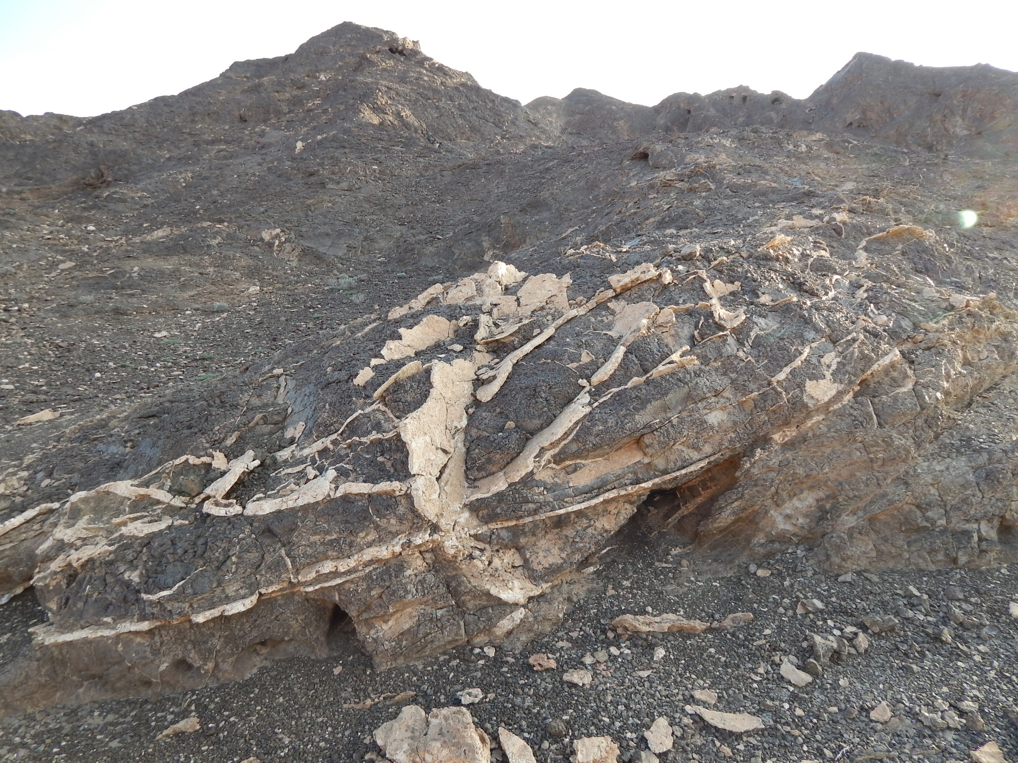
MgCO_{3(s)} + MgCa(CO₃)_{2(s)}
magnesite + dolomite
Notes:
Pictured here are magnesite and dolomite veins that formed subsurface in the peridotite and have now been exposed due to erosion.

Slide 11
Following carbon through the system
(Summarized in 3 steps in Kelemen et al., 2011)
Step 1:
Rain + Air(CO₂) + altered Peridotite = Mg-HCO₃ fluids
Step 2:
Mg-HCO₃ fluids + fresh Peridotite H₂ + Ca-OH fluids +
MgCO_{3(s)} + MgCa(CO₃)_{2(s)}
2

Slide 12
Following carbon through the system
(Summarized in 3 steps in Kelemen et al., 2011)
Step 1:
Rain + Air(CO₂) + altered Peridotite = Mg-HCO₃ fluids
Step 2:
Mg-HCO₃ fluids + fresh Peridotite H₂ + Ca-OH fluids +
MgCO_{3(s)} + MgCa(CO₃)_{2(s)}
Step 3:
Ca-OH fluids + Air = CaCO_{3(s)} precipitation near surface
2
Notes:
In step 3, the Ca-OH fluids return to the surface, mixing with the atmosphere or surface water, resulting in calcium carbonate precipitation at the surface.

Slide 13
CaCO_{3(s)} precipitation at alkaline springs
calcite
Notes:
Here is the title slide picture I showed you, and again, you can see these calcium carbonate deposits covering the surface, presumably sitting on top of ultramafic rocks that contain more magnesium rich carbonates.

Slide 14
Following carbon through the system
(Summarized in 3 steps in Kelemen et al., 2011)
Step 1:
Rain + Air(CO₂) + altered Peridotite = Mg-HCO₃ fluids
Step 2:
Mg-HCO₃ fluids + fresh Peridotite H₂ + Ca-OH fluids +
MgCO_{3(s)} + MgCa(CO₃)_{2(s)}
Step 3:
Ca-OH fluids + Air = CaCO_{3(s)} precipitation near surface
2

Slide 15
Following carbon through the system
(Summarized in 3 steps in Kelemen et al., 2011)
Step 1:
Rain + Air(CO₂) + altered Peridotite = Mg-HCO₃ fluids
Step 2:
Mg-HCO₃ fluids + fresh Peridotite H₂ + Ca-OH fluids +
MgCO_{3(s)} + MgCa(CO₃)_{2(s)}
Step 3:
Ca-OH fluids + Air = CaCO_{3(s)} precipitation near surface
Inorganic Carbon + H₂ = CH₄ + organic acids + other organics
2
Notes:
These are the three reservoirs of inorganic carbon to which I have attempted to link organic acid production.

Slide 16
Serpentinization in Oman
CO₂ input
CH₄ output
CaCO₃
precipitation
MgCO₃
MgCa(CO₃)₂
precipitation
Serpentinizing fluid
+ CH₄, H₂, organic acids
ultramafic rock

Slide 17
Following carbon through the system
(Summarized in 3 steps in Kelemen et al., 2011)
Step 1:
Rain + Air(CO₂) + altered Peridotite = Mg-HCO₃ fluids
Step 2:
Mg-HCO₃ fluids + fresh Peridotite H₂ + Ca-OH fluids +
MgCO_{3(s)} + MgCa(CO₃)_{2(s)}
Step 3:
Ca-OH fluids + Air = CaCO_{3(s)} precipitation near surface
Inorganic Carbon + H₂ = CH₄ + organic acids + other organics
2
Notes:
These are the three reservoirs of inorganic carbon to which I have attempted to link organic acid production.

Slide 18
Following carbon through the system
(Summarized in 3 steps in Kelemen et al., 2011)
Step 1:
Rain + Air(CO₂) + altered Peridotite = Mg-HCO₃ fluids
Step 2:
Mg-HCO₃ fluids + fresh Peridotite H₂ + Ca-OH fluids +
MgCO_{3(s)} + MgCa(CO₃)_{2(s)}
Step 3:
Ca-OH fluids + Air = CaCO_{3(s)} precipitation near surface
Inorganic Carbon + H₂ = CH₄ + organic acids + other organics
2
Notes:
Next, I’d like to examine the aqueous geochemistry of the surface generated Mg bicarb fluids and the subsurface generated calcium hydroxide fluids. I have labeled them blue and green to help you follow along, and note that we could consider the green fluid the “input” fluid, and the blue fluid the “output” fluid.

Slide 19
Mg-HCO₃ fluids
Ca-OH fluids
3
Notes:
Here is a plot of dissolved inorganic carbon versus pH, and in it you can see that the magnesium bicarb fluids are much higher in inorganic carbon than the calcium hydroxide fluids, mainly because of the precipitiation of carbonate minerals, as previously discussed.

Slide 20
H₂ data from Peter Canovas and Alta Howells
Ca-OH fluids
Mg-HCO₃ fluids
Mg-HCO₃ fluids
Ca-OH fluids
3
Notes:
However, the reducing conditions that are generated in the calcium hydroxide fluids, as seen on the right, provide an energetic drive for the reduction of inorganic carbon to organic carbon.

Slide 21
CH₄ data from Peter Canovas and Alta Howells
Ca-OH fluids
Mg-HCO₃ fluids
Mg-HCO₃ fluids
Ca-OH fluids
3
Notes:
Here we can see how methane follows a similar trend as hydrogen; the spread of points for both gases is likely an indicator of how pristine the fluids are, or how little they have sat stagnant or interacted with the atmosphere at the surface. For this talk I’m mainly going to focus on the freshest serpentinized fluid, not the stagnant pools that have degassed and mixed with the atmosphere. Now of course there is an very active ongoing discussion about the reduction of inorganic carbon to methane during serpentinization, but I’m going to focus today on organic acids…

Slide 22
Ca-OH fluids
Mg-HCO₃ fluids
Mg-HCO₃ fluids
Ca-OH fluids
3
Notes:
Which you can see in this formate plot, follow a similar trend to methane.

Slide 23
Ca-OH fluids
Mg-HCO₃ fluids
Mg-HCO₃ fluids
Ca-OH fluids
3
Notes:
Acetate, another organic acid, follows a similar trend, though less pronounced than formate.

Slide 24
% Dissolved Organic Carbon in Ca-OH fluids
Formate
(Average values from 11 samples)
4

Slide 25
Ca-OH fluids
Mg-HCO₃ fluids
Mg-HCO₃ fluids
Ca-OH fluids
3
Notes:
Acetate, another organic acid, follows a similar trend, though less pronounced than formate.

Slide 26
Ca-OH fluids
Mg-HCO₃ fluids
MgCO₃
MgCa(CO₃)₂
CO₃²⁻ precipitation
Mg-HCO₃ fluids
CaCO₃
Ca-OH fluids
3
Notes:
And to remind you, much of the inorganic carbon in these fluids precipitates as carbonates…

Slide 27
Ca-OH fluids
Mg-HCO₃ fluids
MgCO₃
MgCa(CO₃)₂
CO₃²⁻ precipitation
some reduction
Mg-HCO₃ fluids
CaCO₃
Ca-OH fluids
3
Notes:
But a small amount of that carbon is reduced to organic acids…

Slide 28
Ca-OH fluids
Mg-HCO₃ fluids
MgCO₃
MgCa(CO₃)₂
CO₃²⁻ precipitation
some reduction
Mg-HCO₃ fluids
CaCO₃
Ca-OH fluids
Were these organic compounds produced
in the presence of specific carbonate minerals?
3
Notes:
Now the fundamental question of my talk: were these organic compounds produced in the presnece of specific carbonate minerals? For example: fluids whose dissolved inorganic carbon were buffered by specific carbonate minerals

Slide 29
Thermodynamic Analysis:
CaCO₃-Acetate Equilibrium
5
Notes:
To tackle this problem we need to do some equilibrium calculations. Let’s start with calcite-actetate as an example that I can walk you through.

Slide 30
Thermodynamic Analysis:
CaCO₃-Acetate Equilibrium
2CaCO₃ + 3H⁺ + 4H₂ = 2Ca²⁺ + CH₃COO⁻ + 4H₂O
5
Notes:
We can write this balanced reaction between calcite and acetate

Slide 31
Thermodynamic Analysis:
CaCO₃-Acetate Equilibrium
Equilibrium:
K = Q
database
2CaCO₃ + 3H⁺ + 4H₂ = 2Ca²⁺ + CH₃COO⁻ + 4H₂O
5
Notes:
And we can get an equilibrium constant for this reaction from a thermodynamic database

Slide 32
Thermodynamic Analysis:
CaCO₃-Acetate Equilibrium
Equilibrium:
K = Q
database
2CaCO₃ + 3H⁺ + 4H₂ = 2Ca²⁺ + CH₃COO⁻ + 4H₂O
5
Notes:
With just a computer, we can generate this plot of the log K of the reaction versus temperature.

Slide 33
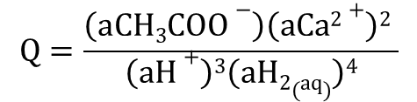
Thermodynamic Analysis:
CaCO₃-Acetate Equilibrium
Equilibrium:
K = Q
database
2CaCO₃ + 3H⁺ + 4H₂ = 2Ca²⁺ + CH₃COO⁻ + 4H₂O
$$Q=\frac{\left(aCH3COO−\right)\left(aCa2+\right)2 }{\left(aH+\right)3\left(aH2(aq)\right)4}$$
5
Notes:
Then we have to recall some general chemistry and remember that at equilibrium, our equilibrium constant is equal to the activity product, also known as the reaction quotient, products over reactants.

Slide 34
Thermodynamic Analysis:
CaCO₃-Acetate Equilibrium
Equilibrium:
K = Q
database
field/lab
work
2CaCO₃ + 3H⁺ + 4H₂ = 2Ca²⁺ + CH₃COO⁻ + 4H₂O
$$Q=\frac{\left(aCH3COO−\right)\left(aCa2+\right)2 }{\left(aH+\right)3\left(aH2(aq)\right)4}$$
5
Notes:
To calculate Q, we have to go to the field and take water samples and make measurements!

Slide 35
Thermodynamic Analysis:
CaCO₃-Acetate Equilibrium
Equilibrium:
K = Q
database
field/lab
work
2CaCO₃ + 3H⁺ + 4H₂ = 2Ca²⁺ + CH₃COO⁻ + 4H₂O
$$Q=\frac{\left(aCH3COO−\right)\left(aCa2+\right)2 }{\left(aH+\right)3\left(aH2(aq)\right)4}$$
5
Notes:
Here’s how Q plots for our 5 freshest samples for which we have all the necessary species in the reaction equation. These 5 sample sites were determined to represent fresh serpentinized fluid based on their high pH, high Ca, high H2, and low Mg contents according to what we think should be happening during active serpentinization. So how can understand this plot? Well, the points that are below the line we could think of as having too little acetate relative to equilibrium, and the point above the line has slightly too much acetate relative to equilibrium.

Slide 36
Thermodynamic Analysis:
CaCO₃-Acetate Equilibrium
Equilibrium:
K = Q
database
field/lab
work
2CaCO₃ + 3H⁺ + 4H₂ = 2Ca²⁺ + CH₃COO⁻ + 4H₂O
$$Q=\frac{\left(aCH3COO−\right)\left(aCa2+\right)2 }{\left(aH+\right)3\left(aH2(aq)\right)4}$$
If: reactants increase,
Then: log Q points move down
5
Notes:
You can see based on the equation, If then

Slide 37
Thermodynamic Analysis:
CaCO₃-Acetate Equilibrium
Equilibrium:
K = Q
database
field/lab
work
2CaCO₃ + 3H⁺ + 4H₂ = 2Ca²⁺ + CH₃COO⁻ + 4H₂O
$$Q=\frac{\left(aCH3COO−\right)\left(aCa2+\right)2 }{\left(aH+\right)3\left(aH2(aq)\right)4}$$
If: reactants increase,
Then: log Q points move down
If: products increase,
Then: log Q points move up
5
Notes:
If then… so if different parts of the system have different amounts of the reactants or products, H2, Ca+2, and so on… those parameters will determine where the system sits relative to equilibrium. Now another thing we can do with this plot is assume the concentrations of solutes are the way they are from their most recent equilibration at a given temperature.

Slide 38
Thermodynamic Analysis:
CaCO₃-Acetate Equilibrium
Equilibrium:
K = Q
database
field/lab
work
2CaCO₃ + 3H⁺ + 4H₂ = 2Ca²⁺ + CH₃COO⁻ + 4H₂O
$$Q=\frac{\left(aCH3COO−\right)\left(aCa2+\right)2 }{\left(aH+\right)3\left(aH2(aq)\right)4}$$
Extrapolate to apparent temperature of equilibration.
5
Notes:
Now another thing we can do with this plot is assume the concentrations of solutes are the way they are from their most recent equilibration, which may be at a higher temperature, called an apparent temperature of equilibration.

Slide 39
Thermodynamic Analysis:
CaCO₃-Acetate Equilibrium
Equilibrium:
K = Q
database
field/lab
work
2CaCO₃ + 3H⁺ + 4H₂ = 2Ca²⁺ + CH₃COO⁻ + 4H₂O
$$Q=\frac{\left(aCH3COO−\right)\left(aCa2+\right)2 }{\left(aH+\right)3\left(aH2(aq)\right)4}$$
Extrapolate to apparent temperature of equilibration.
5
Notes:
We do this for each site by going up in temperature until the Q value matches the K value

Slide 40
Thermodynamic Analysis:
CaCO₃-Acetate Equilibrium
Equilibrium:
K = Q
database
field/lab
work
2CaCO₃ + 3H⁺ + 4H₂ = 2Ca²⁺ + CH₃COO⁻ + 4H₂O
$$Q=\frac{\left(aCH3COO−\right)\left(aCa2+\right)2 }{\left(aH+\right)3\left(aH2(aq)\right)4}$$
Extrapolate to apparent temperature of equilibration.
5
Notes:
And if we do this for all sites we get a range of temperatures for which acetate equilibrated with calcite in the system.

Slide 41
Thermodynamic Analysis:
CaCO₃-Acetate Equilibrium
Equilibrium:
K = Q
database
field/lab
work
2CaCO₃ + 3H⁺ + 4H₂ = 2Ca²⁺ + CH₃COO⁻ + 4H₂O
$$Q=\frac{\left(aCH3COO−\right)\left(aCa2+\right)2 }{\left(aH+\right)3\left(aH2(aq)\right)4}$$
Extrapolate to apparent temperature of equilibration.
Carbonates formed: 23-60 °C
[stable isotope thermometry]
(Keleman et al., 2011; Streit et al., 2012)
23-60 °C
5
Notes:
Interestingly, this falls within the range of carbonate formation temperatures estimated by Keleman et al., 2011 and Streit et al., 2012…
OK so let’s take that plot and clean up the rest of the slide.

Slide 42
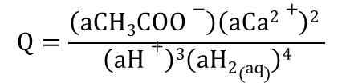
CaCO₃-Acetate
surface
mineral
and
chemistry
$$Q=\frac{\left(aCH3COO−\right)\left(aCa2+\right)2 }{\left(aH+\right)3\left(aH2(aq)\right)4}$$
Equilibrium:
K = Q
25-55 °C
6
Notes:
It looks like our calculations suggest a link between calcite and acetate with the surface chemistry we have.. And calcite generally closer to the surface … but what about other minerals that might be deeper in the system…

Slide 43
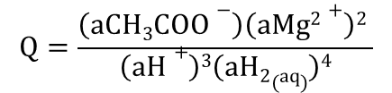
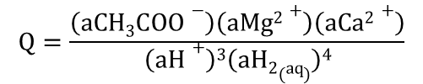
CaCO₃-Acetate
surface chemistry
MgCO₃-Acetate
$$Q=\frac{\left(aCH3COO−\right)\left(aCa2+\right)2 }{\left(aH+\right)3\left(aH2(aq)\right)4}$$
$$Q=\frac{\left(aCH3COO−\right)\left(aMg2+\right)2 }{\left(aH+\right)3\left(aH2(aq)\right)4}$$
Equilibrium:
K = Q
25-55 °C
75-105 °C
MgCa(CO₃)₂-Acetate
$$Q=\frac{\left(aCH3COO−\right)\left(aMg2+\right)\left(aCa2+\right)}{\left(aH+\right)3\left(aH2(aq)\right)4}$$
45-70 °C
6
Notes:
If we do the same treatment for more magnesium rich minerals, magnesite, top right, and dolomite, bottom middle, we get different ranges for our apparent temperature of equilibration. The magnesite range is too high to agree with those carbonate formation temperatures, and the dolomite seems more reasonable. Keep in mind though that we are using the aqueous chemistry we’ve measured in the surface springs, and some of these minerals may be deeper in the system.

Slide 44
CaCO₃-Acetate
surface chemistry
MgCO₃-Acetate
$$Q=\frac{\left(aCH3COO−\right)\left(aCa2+\right)2 }{\left(aH+\right)3\left(aH2(aq)\right)4}$$
$$Q=\frac{\left(aCH3COO−\right)\left(aMg2+\right)2 }{\left(aH+\right)3\left(aH2(aq)\right)4}$$
Equilibrium:
K = Q
25-55 °C
75-105 °C
MgCa(CO₃)₂-Acetate
subsurface?
$$Q=\frac{\left(aCH3COO−\right)\left(aMg2+\right)\left(aCa2+\right)}{\left(aH+\right)3\left(aH2(aq)\right)4}$$
45-70 °C
6
Notes:
What do we know abou subsurface chemistry?

Slide 45
CaCO₃-Acetate
surface chemistry
MgCO₃-Acetate
$$Q=\frac{\left(aCH3COO−\right)\left(aCa2+\right)2 }{\left(aH+\right)3\left(aH2(aq)\right)4}$$
$$Q=\frac{\left(aCH3COO−\right)\left(aMg2+\right)2 }{\left(aH+\right)3\left(aH2(aq)\right)4}$$
Equilibrium:
K = Q
25-55 °C
75-105 °C
MgCa(CO₃)₂-Acetate
subsurface?
well samples
~4x [H₂] (Paukert, 2014)
~2x [Ca²⁺]
slightly lower pH
$$Q=\frac{\left(aCH3COO−\right)\left(aMg2+\right)\left(aCa2+\right)}{\left(aH+\right)3\left(aH2(aq)\right)4}$$
45-70 °C
6
Notes:
From well samples, Amelia Paukert found that there were hydrogen concentrations up to 4x that of our highest hydrogen measurement at the surface!
In addition, our preliminary data suggests that calcium is usually about twice as high at depth, and the pH might be slightly lower.

Slide 46
CaCO₃-Acetate
surface chemistry
well chemistry
MgCO₃-Acetate
$$Q=\frac{\left(aCH3COO−\right)\left(aCa2+\right)2 }{\left(aH+\right)3\left(aH2(aq)\right)4}$$
$$Q=\frac{\left(aCH3COO−\right)\left(aMg2+\right)2 }{\left(aH+\right)3\left(aH2(aq)\right)4}$$
Example:
[H₂] is the most likely measurement to be a minimum at the surface.
4x [H₂] down one well (Paukert, 2014)
Subsurface conditions? apply well [H₂]
25-55 °C
75-105 °C
MgCa(CO₃)₂-Acetate
$$Q=\frac{\left(aCH3COO−\right)\left(aMg2+\right)\left(aCa2+\right)}{\left(aH+\right)3\left(aH2(aq)\right)4}$$
45-70 °C
6
Notes:
When we apply these modifications to the data, we see that our log Q points shift downward quite dramatically, and this is almost entirely due to the [H2], which is the parameter which has the biggest effect. When we calculate apparent temperatures of equilibration to coincide with this deeper well chemistry, we get higher temperatures.

Slide 47
CaCO₃-Acetate
surface chemistry
well chemistry
MgCO₃-Acetate
$$Q=\frac{\left(aCH3COO−\right)\left(aCa2+\right)2 }{\left(aH+\right)3\left(aH2(aq)\right)4}$$
$$Q=\frac{\left(aCH3COO−\right)\left(aMg2+\right)2 }{\left(aH+\right)3\left(aH2(aq)\right)4}$$
Example:
[H₂] is the most likely measurement to be a minimum at the surface.
4x [H₂] down one well (Paukert, 2014)
Subsurface conditions? apply well [H₂]
25-55 °C
75-80 °C
75-105 °C
130-140 °C
MgCa(CO₃)₂-Acetate
$$Q=\frac{\left(aCH3COO−\right)\left(aMg2+\right)\left(aCa2+\right)}{\left(aH+\right)3\left(aH2(aq)\right)4}$$
45-70 °C
90-100 °C
6
Notes:
All of these temperatures seem too high for the current system we are looking at.

Slide 48
CaCO₃-Acetate
surface chemistry
well chemistry
MgCO₃-Acetate
$$Q=\frac{\left(aCH3COO−\right)\left(aCa2+\right)2 }{\left(aH+\right)3\left(aH2(aq)\right)4}$$
$$Q=\frac{\left(aCH3COO−\right)\left(aMg2+\right)2 }{\left(aH+\right)3\left(aH2(aq)\right)4}$$
Example:
[H₂] is the most likely measurement to be a minimum at the surface.
4x [H₂] down one well (Paukert, 2014)
Subsurface conditions? apply well [H₂]
25-55 °C
75-80 °C
75-105 °C
130-140 °C
MgCa(CO₃)₂-Acetate
Best match
$$Q=\frac{\left(aCH3COO−\right)\left(aMg2+\right)\left(aCa2+\right)}{\left(aH+\right)3\left(aH2(aq)\right)4}$$
45-70 °C
90-100 °C
6
Notes:
It looks like acetate-calcite equilibrium is our best match.

Slide 49
CaCO₃-Acetate
surface chemistry
well chemistry
MgCO₃-Acetate
$$Q=\frac{\left(aCH3COO−\right)\left(aCa2+\right)2 }{\left(aH+\right)3\left(aH2(aq)\right)4}$$
$$Q=\frac{\left(aCH3COO−\right)\left(aMg2+\right)2 }{\left(aH+\right)3\left(aH2(aq)\right)4}$$
Example:
[H₂] is the most likely measurement to be a minimum at the surface.
4x [H₂] down one well (Paukert, 2014)
Subsurface conditions? apply well [H₂]
25-55 °C
75-80 °C
75-105 °C
130-140 °C
MgCa(CO₃)₂-Acetate
Best match:
Surface-formed Acetate:
calcite (CaCO₃),
surface chemistry
$$Q=\frac{\left(aCH3COO−\right)\left(aMg2+\right)\left(aCa2+\right)}{\left(aH+\right)3\left(aH2(aq)\right)4}$$
45-70 °C
90-100 °C
6
Notes:
Which implies that acetate is formed near the surface, in the presence of calcite, with the associated surface chemistry

Slide 50
CaCO₃-Acetate
surface chemistry
well chemistry
MgCO₃-Acetate
$$Q=\frac{\left(aCH3COO−\right)\left(aCa2+\right)2 }{\left(aH+\right)3\left(aH2(aq)\right)4}$$
$$Q=\frac{\left(aCH3COO−\right)\left(aMg2+\right)2 }{\left(aH+\right)3\left(aH2(aq)\right)4}$$
Example:
[H₂] is the most likely measurement to be a minimum at the surface.
4x [H₂] down one well (Paukert, 2014)
Subsurface conditions? apply well [H₂]
25-55 °C
75-80 °C
75-105 °C
130-140 °C
MgCa(CO₃)₂-Acetate
Best match:
Surface-formed Acetate:
calcite (CaCO₃),
surface chemistry
Carbonate formation temperatures:
23-60 °C
(Kelemen et al., 2011;
Streit et al., 2012)
$$Q=\frac{\left(aCH3COO−\right)\left(aMg2+\right)\left(aCa2+\right)}{\left(aH+\right)3\left(aH2(aq)\right)4}$$
45-70 °C
90-100 °C
6
Notes:
Again, this agrees with modern carbonate formation temperatures.

Slide 51
CaCO₃-Acetate
surface chemistry
well chemistry
MgCO₃-Acetate
$$Q=\frac{\left(aCH3COO−\right)\left(aCa2+\right)2 }{\left(aH+\right)3\left(aH2(aq)\right)4}$$
$$Q=\frac{\left(aCH3COO−\right)\left(aMg2+\right)2 }{\left(aH+\right)3\left(aH2(aq)\right)4}$$
Example:
[H₂] is the most likely measurement to be a minimum at the surface.
4x [H₂] down one well (Paukert, 2014)
Subsurface conditions? apply well [H₂]
25-55 °C
75-80 °C
75-105 °C
130-140 °C
MgCa(CO₃)₂-Acetate
Best match:
Surface-formed Acetate:
calcite (CaCO₃),
surface chemistry
Carbonate formation temperatures:
23-60 °C
(Kelemen et al., 2011;
Streit et al., 2012)
$$Q=\frac{\left(aCH3COO−\right)\left(aMg2+\right)\left(aCa2+\right)}{\left(aH+\right)3\left(aH2(aq)\right)4}$$
2nd Best match?
45-70 °C
90-100 °C
6
Notes:
It’s tempting to look at this and think dolomite is a close runner up, but

Slide 52
CaCO₃-Acetate
surface chemistry
well chemistry
MgCO₃-Acetate
$$Q=\frac{\left(aCH3COO−\right)\left(aCa2+\right)2 }{\left(aH+\right)3\left(aH2(aq)\right)4}$$
$$Q=\frac{\left(aCH3COO−\right)\left(aMg2+\right)2 }{\left(aH+\right)3\left(aH2(aq)\right)4}$$
Example:
[H₂] is the most likely measurement to be a minimum at the surface.
4x [H₂] down one well (Paukert, 2014)
Subsurface conditions? apply well [H₂]
25-55 °C
75-80 °C
75-105 °C
130-140 °C
MgCa(CO₃)₂-Acetate
Best match:
Surface-formed Acetate:
calcite (CaCO₃),
surface chemistry
Carbonate formation temperatures:
23-60 °C
(Kelemen et al., 2011;
Streit et al., 2012)
$$Q=\frac{\left(aCH3COO−\right)\left(aMg2+\right)\left(aCa2+\right)}{\left(aH+\right)3\left(aH2(aq)\right)4}$$
2nd Best match?
45-70 °C
90-100 °C
6
Notes:
Because dolomite is probably deeper in the active system, and has associated water chemistry approaching that of the well, the apparent temperature of equilibration is too high, and thus doesn’t fit.
What about formate?

Slide 53
What about formate’s source?
Last equilibrated with which carbonate mineral?
Surface or subsurface?
Equilibrium:
K = Q
Notes:
Try CaCO3 => formate (solve for depth for each sample)

Slide 54
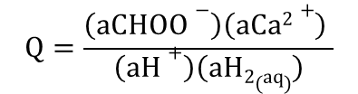
CaCO₃-Formate
surface chemistry
$$Q=\frac{\left(aCHOO−\right)\left(aCa2+\right) }{\left(aH+\right)\left(aH2(aq)\right)}$$
Equilibrium:
K = Q
7
Notes:
Same treatment for calcite-formate EQ, right off the bat it looks strange. The log Q points are above the line. How could the system overproduce formate relative to equilibrium.

Slide 55
CaCO₃-Formate
surface chemistry
$$Q=\frac{\left(aCHOO−\right)\left(aCa2+\right) }{\left(aH+\right)\left(aH2(aq)\right)}$$
Equilibrium:
K = Q
<< 0 °C
7
Notes:
Furthermoe, when we try to calculate an apparent temperature of EQ, it’s below freezing, just silly for our system. This is a big indicator that we’re not looking at the right reaction!

Slide 56
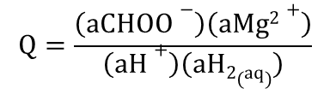
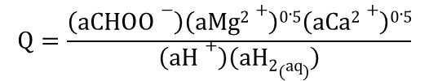
CaCO₃-Formate
surface chemistry
MgCO₃-Formate
$$Q=\frac{\left(aCHOO−\right)\left(aCa2+\right) }{\left(aH+\right)\left(aH2(aq)\right)}$$
$$Q=\frac{\left(aCHOO−\right)\left(aMg2+\right)}{\left(aH+\right)\left(aH2(aq)\right)}$$
Equilibrium:
K = Q
<< 0 °C
70-115 °C
MgCa(CO₃)₂-Formate
$$Q=\frac{\left(aCHOO−\right)\left(aMg2+\right)0.5\left(aCa2+\right)0.5}{\left(aH+\right)\left(aH2(aq)\right)}$$
< 0 - 25 °C
7
Notes:
OK so let’s look at the other carbonate mineral options. Dolomite is also too low. Magnesite is too high. It looks like there are no good options. Except wait! We have our subsurface chemistry indications from the well measurements.

Slide 57
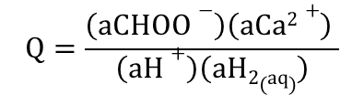
CaCO₃-Formate
surface chemistry
well chemistry
MgCO₃-Formate
$$Q=\frac{\left(aCHOO−\right)\left(aCa2+\right) }{\left(aH+\right)\left(aH2(aq)\right)}$$
$$Q=\frac{\left(aCHOO−\right)\left(aMg2+\right)}{\left(aH+\right)\left(aH2(aq)\right)}$$
Equilibrium:
K = Q
0 °C
> 125 °C
<< 0 °C
70-115 °C
MgCa(CO₃)₂-Formate
$$Q=\frac{\left(aCHOO−\right)\left(aMg2+\right)0.5\left(aCa2+\right)0.5}{\left(aH+\right)\left(aH2(aq)\right)}$$
< 0 - 25 °C
40-60 °C
7
Notes:
When we apply the well chemistry, calcite still looks like a bad choice. Magnesite looks even worse, but suddenly, our dolomite-formate apparent temperature of equilibration hits a reasonable range!

Slide 58
CaCO₃-Formate
surface chemistry
well chemistry
MgCO₃-Formate
$$Q=\frac{\left(aCHOO−\right)\left(aCa2+\right) }{\left(aH+\right)\left(aH2(aq)\right)}$$
$$Q=\frac{\left(aCHOO−\right)\left(aMg2+\right)}{\left(aH+\right)\left(aH2(aq)\right)}$$
Equilibrium:
K = Q
0 °C
> 125 °C
<< 0 °C
70-115 °C
MgCa(CO₃)₂-Formate
Best match
$$Q=\frac{\left(aCHOO−\right)\left(aMg2+\right)0.5\left(aCa2+\right)0.5}{\left(aH+\right)\left(aH2(aq)\right)}$$
< 0 - 25 °C
40-60 °C
7
Notes:
It is our best match

Slide 59
CaCO₃-Formate
surface chemistry
well chemistry
MgCO₃-Formate
$$Q=\frac{\left(aCHOO−\right)\left(aCa2+\right) }{\left(aH+\right)\left(aH2(aq)\right)}$$
$$Q=\frac{\left(aCHOO−\right)\left(aMg2+\right)}{\left(aH+\right)\left(aH2(aq)\right)}$$
Equilibrium:
K = Q
0 °C
> 125 °C
<< 0 °C
70-115 °C
MgCa(CO₃)₂-Formate
Best match:
Subsurface Formate:
dolomite [MgCa(CO₃)₂], subsurface chemistry
$$Q=\frac{\left(aCHOO−\right)\left(aMg2+\right)0.5\left(aCa2+\right)0.5}{\left(aH+\right)\left(aH2(aq)\right)}$$
< 0 - 25 °C
40-60 °C
7
Notes:
This suggests that formate production is linked to the presence of dolomite and subsurface chemistry

Slide 60
CaCO₃-Formate
surface chemistry
well chemistry
MgCO₃-Formate
$$Q=\frac{\left(aCHOO−\right)\left(aCa2+\right) }{\left(aH+\right)\left(aH2(aq)\right)}$$
$$Q=\frac{\left(aCHOO−\right)\left(aMg2+\right)}{\left(aH+\right)\left(aH2(aq)\right)}$$
Equilibrium:
K = Q
0 °C
> 125 °C
<< 0 °C
70-115 °C
MgCa(CO₃)₂-Formate
Best match:
Subsurface Formate:
dolomite [MgCa(CO₃)₂], subsurface chemistry
Carbonate formation temperatures:
23-60 °C
(Kelemen et al., 2011;
Streit et al., 2012)
$$Q=\frac{\left(aCHOO−\right)\left(aMg2+\right)0.5\left(aCa2+\right)0.5}{\left(aH+\right)\left(aH2(aq)\right)}$$
< 0 - 25 °C
40-60 °C
7
Notes:
And again, this fits into this low temperature range.

Slide 61
CaCO₃-Formate
surface chemistry
well chemistry
MgCO₃-Formate
$$Q=\frac{\left(aCHOO−\right)\left(aCa2+\right) }{\left(aH+\right)\left(aH2(aq)\right)}$$
$$Q=\frac{\left(aCHOO−\right)\left(aMg2+\right)}{\left(aH+\right)\left(aH2(aq)\right)}$$
Equilibrium:
K = Q
0 °C
> 125 °C
<< 0 °C
70-115 °C
MgCa(CO₃)₂-Formate
Best match:
Subsurface Formate:
dolomite [MgCa(CO₃)₂], subsurface chemistry
Carbonate formation temperatures:
23-60 °C
(Kelemen et al., 2011;
Streit et al., 2012)
$$Q=\frac{\left(aCHOO−\right)\left(aMg2+\right)0.5\left(aCa2+\right)0.5}{\left(aH+\right)\left(aH2(aq)\right)}$$
MgCa(CO₃)₂ > MgCO₃
in mineralogy of veins (Streit et al, 2012)
< 0 - 25 °C
40-60 °C
7
Notes:
And additionally, the mineralogy from Streit et al., 2012 suggests that dolomite dominates over magnesite in the carbonate veins in the system.

Slide 62
Organic Acid Predictions
0 m
CaCO₃
Acetate
Increasing Depth
Formate
MgCO₃, MgCa(CO₃)₂
Increasing [Organic Acids]
8
Notes:
Here is a cartoon of the organic acid predictions in the subsurface, based on these calculations, showing that formate could be a signal coming from deeper conditions with deeper mineralogy and chemistry, while acetate is being formed right at the surface.

Slide 63
Organic Acid Predictions
0 m
CaCO₃
Acetogens?
Acetate
Increasing Depth
Formate
MgCO₃, MgCa(CO₃)₂
Formatogens?
Abiotic organic synthesis?
Increasing [Organic Acids]
8
Notes:
Since this is a low temperature system, it would make sense that these predictions might have accompanying biology catalyzing the reactions that form these organic acids.

Slide 64
Organic Acid Predictions
Tested upon Drilling!
0 m
CaCO₃
Acetogens?
Acetate
Increasing Depth
Formate
MgCO₃, MgCa(CO₃)₂
Formatogens?
Abiotic organic synthesis?
Increasing [Organic Acids]
8
Notes:
And excitingly this can all be tested with measurements from drilling into the system.

Slide 65
Equilibrium:
K = Q
Methane is more complicated…
Notes:
Try CaCO3 => formate (solve for depth for each sample)

Slide 66
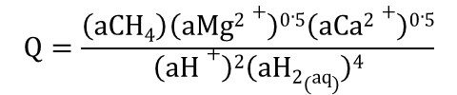
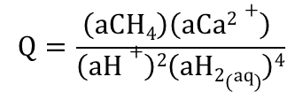
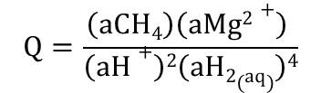
CaCO₃-Methane
surface chemistry
well chemistry
MgCO₃-Methane
$$Q=\frac{\left(aCH4\right)\left(aCa2+\right) }{\left(aH+\right)2\left(aH2(aq)\right)4}$$
$$Q=\frac{\left(aCH4\right)\left(aMg2+\right) }{\left(aH+\right)2\left(aH2(aq)\right)4}$$
Equilibrium:
K = Q
110 °C
> 140 °C
80 - 120 °C
>110 °C
MgCa(CO₃)₂-Methane
$$Q=\frac{\left(aCH4\right)\left(aMg2+\right)0.5\left(aCa2+\right)0.5}{\left(aH+\right)2\left(aH2(aq)\right)4}$$
120 - 130 °C
90 - 140 °C
9
Notes:
There could be a few different reasons for this but I’m going to focus on one possibility in particular

Slide 67
CaCO₃-Methane
surface chemistry
well chemistry
MgCO₃-Methane
$$Q=\frac{\left(aCH4\right)\left(aCa2+\right) }{\left(aH+\right)2\left(aH2(aq)\right)4}$$
$$Q=\frac{\left(aCH4\right)\left(aMg2+\right) }{\left(aH+\right)2\left(aH2(aq)\right)4}$$
Equilibrium:
K = Q
110 °C
> 140 °C
80 - 120 °C
>110 °C
MgCa(CO₃)₂-Methane
The predicted formation temperatures are too hot.
$$Q=\frac{\left(aCH4\right)\left(aMg2+\right)0.5\left(aCa2+\right)0.5}{\left(aH+\right)2\left(aH2(aq)\right)4}$$
120 - 130 °C
90 - 140 °C
9
Notes:
There could be a few different reasons for this but I’m going to focus on one possibility in particular

Slide 68
CaCO₃-Methane
surface chemistry
well chemistry
MgCO₃-Methane
$$Q=\frac{\left(aCH4\right)\left(aCa2+\right) }{\left(aH+\right)2\left(aH2(aq)\right)4}$$
$$Q=\frac{\left(aCH4\right)\left(aMg2+\right) }{\left(aH+\right)2\left(aH2(aq)\right)4}$$
Equilibrium:
K = Q
110 °C
> 140 °C
80 - 120 °C
>110 °C
MgCa(CO₃)₂-Methane
The predicted formation temperatures are too hot.
[Methane] is too low.
$$Q=\frac{\left(aCH4\right)\left(aMg2+\right)0.5\left(aCa2+\right)0.5}{\left(aH+\right)2\left(aH2(aq)\right)4}$$
120 - 130 °C
90 - 140 °C
9
Notes:
There could be a few different reasons for this but I’m going to focus on one possibility in particular

Slide 69
CaCO₃-Methane
surface chemistry
well chemistry
MgCO₃-Methane
$$Q=\frac{\left(aCH4\right)\left(aCa2+\right) }{\left(aH+\right)2\left(aH2(aq)\right)4}$$
$$Q=\frac{\left(aCH4\right)\left(aMg2+\right) }{\left(aH+\right)2\left(aH2(aq)\right)4}$$
Equilibrium:
K = Q
110 °C
> 140 °C
80 - 120 °C
>110 °C
MgCa(CO₃)₂-Methane
The predicted formation temperatures are too hot.
[Methane] is too low.
Why could this be?
$$Q=\frac{\left(aCH4\right)\left(aMg2+\right)0.5\left(aCa2+\right)0.5}{\left(aH+\right)2\left(aH2(aq)\right)4}$$
120 - 130 °C
90 - 140 °C
9
Notes:
There could be a few different reasons for this but I’m going to focus on one possibility in particular

Slide 70
Maybe the system runs out of carbon.
10
Notes:
There could be a few different reasons for this but I’m going to focus on one possibility in particular

Slide 71
Maybe the system runs out of carbon.
MgCO₃ + 2H⁺ + 4H₂ = Mg²⁺ + CH₄ + 3H₂O
MgCO₃-Methane
> 140 °C
>110 °C
10
Notes:
There could be a few different reasons for this but I’m going to focus on one possibility in particular

Slide 72
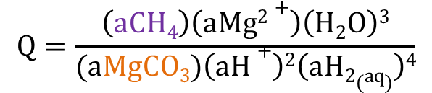
Maybe the system runs out of carbon.
MgCO₃ + 2H⁺ + 4H₂ = Mg²⁺ + CH₄ + 3H₂O
MgCO₃-Methane
$$Q=\frac{\left(aCH4\right)\left(aMg2+\right)\left(H2O\right)3}{(aMgCO3)\left(aH+\right)2\left(aH2(aq)\right)4}$$
> 140 °C
>110 °C
10
Notes:
There could be a few different reasons for this but I’m going to focus on one possibility in particular

Slide 73
Maybe the system runs out of carbon.
MgCO₃ + 2H⁺ + 4H₂ = Mg²⁺ + CH₄ + 3H₂O
MgCO₃-Methane
$$Q=\frac{\left(aCH4\right)\left(aMg2+\right)\left(H2O\right)3}{(aMgCO3)\left(aH+\right)2\left(aH2(aq)\right)4}$$
If: reactants decrease,
Then: log Q points move up
> 140 °C
>110 °C
10
Notes:
There could be a few different reasons for this but I’m going to focus on one possibility in particular

Slide 74
Maybe the system runs out of carbon.
MgCO₃ + 2H⁺ + 4H₂ = Mg²⁺ + CH₄ + 3H₂O
MgCO₃ = Mg²⁺ + CO₃²⁻
MgCO₃-Methane
At equilbrium:
aCO₃²⁻ ≈ 10^{-2.5}
> 140 °C
>110 °C
10
Notes:
There could be a few different reasons for this but I’m going to focus on one possibility in particular

Slide 75
Maybe the system runs out of carbon.
MgCO₃ + 2H⁺ + 4H₂ = Mg²⁺ + CH₄ + 3H₂O
MgCO₃ = Mg²⁺ + CO₃²⁻
MgCO₃-Methane
At equilbrium:
aCO₃²⁻ ≈ 10^{-2.5}
(CaMg(CO₃)₂ eq: aCO₃²⁻ ≈ 10^{-4.5})
(CaCO₃ eq: aCO₃²⁻ ≈ 10^{-5.5})
> 140 °C
>110 °C
10
Notes:
There could be a few different reasons for this but I’m going to focus on one possibility in particular

Slide 76
Maybe the system runs out of carbon.
MgCO₃ + 2H⁺ + 4H₂ = Mg²⁺ + CH₄ + 3H₂O
MgCO₃ = Mg²⁺ + CO₃²⁻
MgCO₃-Methane
At equilbrium:
aCO₃²⁻ ≈ 10^{-2.5}
(CaMg(CO₃)₂ eq. ≈ 10^{-4.5},
CaCO₃ eq. ≈ 10^{-5.5})
CO₃²⁻ + 2H⁺ + 4H₂ = CH₄ + 3H₂O
> 140 °C
>110 °C
10
Notes:
There could be a few different reasons for this but I’m going to focus on one possibility in particular

Slide 77
Maybe the system runs out of carbon.
MgCO₃ + 2H⁺ + 4H₂ = Mg²⁺ + CH₄ + 3H₂O
MgCO₃ = Mg²⁺ + CO₃²⁻
MgCO₃-Methane
(CaMg(CO₃)₂ aCO₃²⁻ ≈ 10^{-4.5},
CaCO₃ aCO₃²⁻ ≈ 10^{-5.5})
At equilbrium:
aCO₃²⁻ ≈ 10^{-2.5}
CO₃²⁻ + 2H⁺ + 4H₂ = CH₄ + 3H₂O
Given the aCH₄ we measure,
At equilbrium:
aCO₃²⁻ ≈ 10⁻¹⁵ !
> 140 °C
>110 °C
10
Notes:
There could be a few different reasons for this but I’m going to focus on one possibility in particular

Slide 78
Maybe the system runs out of carbon.
MgCO₃ + 2H⁺ + 4H₂ = Mg²⁺ + CH₄ + 3H₂O
MgCO₃ = Mg²⁺ + CO₃²⁻
MgCO₃-Methane
(CaMg(CO₃)₂ aCO₃²⁻ ≈ 10^{-4.5},
CaCO₃ aCO₃²⁻ ≈ 10^{-5.5})
At equilbrium:
aCO₃²⁻ ≈ 10^{-2.5}
CO₃²⁻ + 2H⁺ + 4H₂ = CH₄ + 3H₂O
Given the aCH₄ we measure,
At equilbrium:
aCO₃²⁻ ≈ 10⁻¹⁵ !
> 140 °C
>110 °C
aCO₃²⁻ : 10^{-2.5} 10⁻¹⁵
10
Notes:
There could be a few different reasons for this but I’m going to focus on one possibility in particular

Slide 79
Maybe the system runs out of carbon.
MgCO₃ + 2H⁺ + 4H₂ = Mg²⁺ + CH₄ + 3H₂O
MgCO₃ = Mg²⁺ + CO₃²⁻
MgCO₃-Methane
(CaMg(CO₃)₂ aCO₃²⁻ ≈ 10^{-4.5},
CaCO₃ aCO₃²⁻ ≈ 10^{-5.5})
At equilbrium:
aCO₃²⁻ ≈ 10^{-2.5}
CO₃²⁻ + 2H⁺ + 4H₂ = CH₄ + 3H₂O
Given the aCH₄ we measure,
At equilbrium:
aCO₃²⁻ ≈ 10⁻¹⁵ !
> 140 °C
>110 °C
aCO₃²⁻ : 10^{-2.5} 10⁻¹⁵ 99.999...% conversion to CH₄
in the active zone?
10
Notes:
There could be a few different reasons for this but I’m going to focus on one possibility in particular

Slide 80
Following carbon through the system
(Summarized in 3 steps in Kelemen et al., 2011)
Step 1:
Rain + Air(CO₂) + altered Peridotite = Mg-HCO₃ fluids
Step 2:
Mg-HCO₃ fluids + fresh Peridotite H₂ + Ca-OH fluids +
MgCO_{3(s)} + MgCa(CO₃)_{2(s)}
Step 3:
Ca-OH fluids + Air = CaCO_{3(s)} precipitation near surface
Inorganic Carbon + H₂ = CH₄ + organic acids + other organics
Notes:
These are the three reservoirs of inorganic carbon to which I have attempted to link organic acid production.

Slide 81
Following carbon through the system
(Summarized in 3 steps in Kelemen et al., 2011)
Step 1:
Rain + Air(CO₂) + altered Peridotite = Mg-HCO₃ fluids
Step 2:
Mg-HCO₃ fluids + fresh Peridotite H₂ + Ca-OH fluids +
MgCO_{3(s)} + MgCa(CO₃)_{2(s)}
Step 3:
Ca-OH fluids + Air = CaCO_{3(s)} precipitation near surface
Inorganic Carbon + H₂ = CH₄ + organic acids + other organics
Faster (1st):
Slower (2nd):
Notes:
These are the three reservoirs of inorganic carbon to which I have attempted to link organic acid production.

Slide 82
Hypothesis: ~Complete inorganic carbon conversion to CH₄ in the active zone
11

Slide 83
Hypothesis: ~Complete inorganic carbon conversion to CH₄ in the active zone
Isotopic (¹³C) measurements:
Mg-rich carbonates (Melvine et al., 2014) CH₄ in Ca-OH fluid
11

Slide 84
Hypothesis: ~Complete inorganic carbon conversion to CH₄ in the active zone
Isotopic (¹³C) measurements:
Mg-rich carbonates (Melvine et al., 2014) CH₄ in Ca-OH fluid
-12 to 0 ‰δ¹³C_{VPDB} -10 to -1 ‰δ¹³C_{VPDB}
MgCO₃
CaMg(CO₃)₂
CH₄
∆¹³C
~0 ‰
Fractionation
Reduction
11
Notes:
So if you have an initial reservoir of carbon 12 and carbon 13 atoms with a certain ratio of C12 to C13, and you convert the entire thing, then your product should maintain the same ratio. Whereas if you just converted some of your initial reservoir, the process may select for one isotope over the other.

Slide 85
Hypothesis: ~Complete inorganic carbon conversion to CH₄ in the active zone
Isotopic (¹³C) measurements:
Mg-rich carbonates (Melvine et al., 2014) CH₄ in Ca-OH fluid
-12 to 0 ‰δ¹³C_{VPDB} -10 to -1 ‰δ¹³C_{VPDB}
consistent with hypothesis
Notes:
So this finding is consistent with the hypothesis of almost complete conversion of inorganic carbon to methane.

Slide 86
Hypothesis: ~Complete inorganic carbon conversion to CH₄ in the active zone
Isotopic (¹³C) measurements:
Mg-rich carbonates (Melvine et al., 2014) CH₄ in Ca-OH fluid
-12 to 0 ‰δ¹³C_{VPDB} -10 to -1 ‰δ¹³C_{VPDB}
consistent with hypothesis
Theoretical reaction path modeling (James Leong, EQ36):
11

Slide 87
Hypothesis: ~Complete inorganic carbon
conversion to CH₄ in the active zone
Isotopic (¹³C) measurements:
Mg-rich carbonates (Melvine et al., 2014) CH₄ in Ca-OH fluid
-12 to 0 ‰δ¹³C_{VPDB} -10 to -1 ‰δ¹³C_{VPDB}
consistent with hypothesis
Theoretical reaction path modeling (James Leong, EQ36):
Predicts carbonate precipitation, then CH₄ production.
11

Slide 88
Hypothesis: ~Complete inorganic carbon conversion to CH₄ in the active zone
Isotopic (¹³C) measurements:
Mg-rich carbonates (Melvine et al., 2014) CH₄ in Ca-OH fluid
-12 to 0 ‰δ¹³C_{VPDB} -10 to -1 ‰δ¹³C_{VPDB}
consistent with hypothesis
Theoretical reaction path modeling (James Leong, EQ36):
Predicts carbonate precipitation, then CH₄ production.
(after 1 g rock reacts with 1 L H₂O)
aCO₃²⁻ : 10⁻⁷ 10⁻³⁰
11

Slide 89
Hypothesis: ~Complete inorganic carbon conversion to CH₄ in the active zone
Isotopic (¹³C) measurements:
Mg-rich carbonates (Melvine et al., 2014) CH₄ in Ca-OH fluid
-12 to 0 ‰δ¹³C_{VPDB} -10 to -1 ‰δ¹³C_{VPDB}
consistent with hypothesis
Theoretical reaction path modeling (James Leong, EQ36):
Predicts carbonate precipitation, then CH₄ production. (after 1 g rock reacts with 1 L H₂O)
consistent with hypothesis
aCO₃²⁻ : 10⁻⁷ 10⁻³⁰
11

Slide 90
Hypothesis: ~Complete inorganic carbon conversion to CH₄ in the active zone
Isotopic (¹³C) measurements:
Mg-rich carbonates (Melvine et al., 2014) CH₄ in Ca-OH fluid
-12 to 0 ‰δ¹³C_{VPDB} -10 to -1 ‰δ¹³C_{VPDB}
consistent with hypothesis
Theoretical reaction path modeling (James Leong, EQ36):
Predicts carbonate precipitation, then CH₄ production. (after 1 g rock reacts with 1 L H₂O)
consistent with hypothesis
aCO₃²⁻ : 10⁻⁷ 10⁻³⁰
Implications for characterizing abiotic methane?
11
Notes:
Figure out more James’ stuff

Slide 91
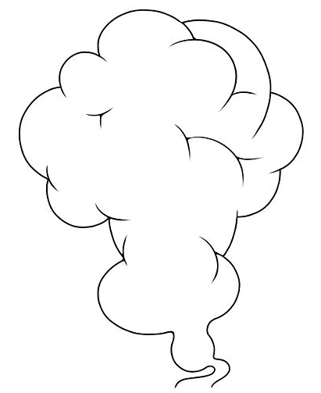
Distinguishing sources of methane
Biogenic: produced from living microbes
Thermogenic: from heating dead biomass
Abiotic: from inorganic carbon (no life or organics)
atmosphere
subsurface
Methane
Biogenic Thermogenic Abiotic
13

Slide 92

Distinguishing sources of methane
Biogenic: produced from living microbes
Thermogenic: from heating dead biomass
Abiotic: from inorganic carbon (no life or organics)
atmosphere
subsurface
Methane
Biogenic Thermogenic Abiotic
13

Slide 93
Distinguishing sources of methane
Biogenic: produced from living microbes
Thermogenic: from heating dead biomass
Abiotic: from inorganic carbon (no life or organics)
atmosphere
subsurface
Methane
Biogenic Thermogenic Abiotic
13

Slide 94

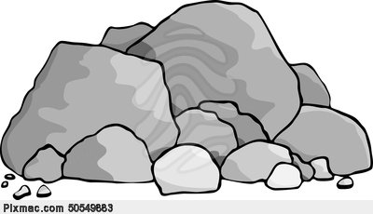
Distinguishing sources of methane
Biogenic: produced from living microbes
Thermogenic: from heating dead biomass
Abiotic: from inorganic carbon (no life or organics)
atmosphere
subsurface
Methane
Biogenic Thermogenic Abiotic
13

Slide 95
Distinguishing sources of methane
atmosphere
subsurface
Methane
Biogenic Thermogenic Abiotic
13

Slide 96
Distinguishing sources of methane
δ¹³C
atmosphere
subsurface
Methane
∆¹³C_{Bio}
∆¹³C_{Abio}
∆¹³C_{Thermo}
Biogenic Thermogenic Abiotic
13

Slide 97
Distinguishing sources of methane
δ¹³C
atmosphere
Typically very negative
(e.g. -40 ‰∆¹³C_{Bio})
subsurface
Methane
∆¹³C_{Bio}
∆¹³C_{Abio}
∆¹³C_{Thermo}
Biogenic Thermogenic Abiotic
13
Notes:
And thus the thermogenic 13C measured is usually thought to be negative, since it comes from biomass.

Slide 98
Distinguishing sources of methane
¹²C_{inorganic}
¹²CH₄
Surplus
supplies
¹²C_{inorganic}
¹²CH₄
¹³C_{inorganic}

Slide 99

Distinguishing sources of methane
¹²C_{inorganic}
¹²CH₄
¹²C_{inorganic}
¹²CH₄
¹³C_{inorganic}
Surplus
supplies
Better building material
Worse building material
11

Slide 100
Distinguishing sources of methane
¹²C_{inorganic}
¹²CH₄
¹³C_{inorganic}
¹³CH₄
Limited
supplies
Better material
Worse material
11

Slide 101
Distinguishing sources of methane
Commonly used indicator for abiotic methane:
“Heavier” methane (more ¹³C)
atmosphere
subsurface
Methane
Biogenic Thermogenic Abiotic
13

Slide 102
Distinguishing sources of methane
Commonly used indicator for abiotic methane:
“Heavier” methane (more ¹³C)
But if ~complete C_{inorganic} to CH₄ conversion:
Cannot distinguish ‰∆¹³C_{Bio} from ‰∆¹³C_{Abio}
atmosphere
subsurface
Methane
Biogenic Thermogenic Abiotic
13
Notes:
Due to a combination of the thermodynamics and kinetics of the system…

Slide 103
Lessons from the field:
14

Slide 104
Lessons from the field:
Acetate last equilibrated with CaCO₃ near the surface (biogenic?)
Formate last equlibrated with CaMg(CO₃)₂ deeper in the system (abiotic?)
If no inorganic carbon in active zone, more work to do figuring out the abiotic vs biogenic contributions to [CH₄]
14

Slide 105
Lessons from the field:
Acetate last equilibrated with CaCO₃ near the surface (biogenic?)
Formate last equilibrated with CaMg(CO₃)₂ deeper in the system (abiotic?)
If no inorganic carbon in active zone, more work to do figuring out the abiotic vs biogenic contributions to [CH₄]
14

Slide 106
Lessons from the field:
Acetate last equilibrated with CaCO₃ near the surface (biogenic?)
Formate last equilibrated with CaMg(CO₃)₂ deeper in the system (abiotic?)
Methane may have equilibrated in a part of the system where inorganic carbon runs out.
If so, δ¹³C cannot be used to distinguish abiotic vs biogenic
14

Slide 107
Lessons from the field:
Acetate last equilibrated with CaCO₃ near the surface (biogenic?)
Formate last equilibrated with CaMg(CO₃)₂ deeper in the system (abiotic?)
Methane may have equilibrated in a part of the system where inorganic carbon runs out.
If so, δ¹³C cannot be used to distinguish abiotic vs biogenic (Drilling will help!)
14

Slide 109
Types of methane (or other organics)
Biogenic: produced from living microbes
Thermogenic: from heating dead biomass
Abiotic: from inorganic carbon (no life or organics)
12

Slide 110
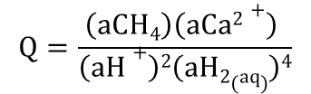
[CH₄] too low for moderate T of equilibration
List of possible reasons:
CaCO₃ + 2H⁺ + 4H₂ = Ca²⁺ + CH₄ + 3H₂O
$$Q=\frac{\left(aCH4\right)\left(aCa2+\right) }{\left(aH+\right)2\left(aH2(aq)\right)4}$$
Biological oxidation of methane could be occurring (but wouldn’t H₂ also?).
The system ran out of inorganic carbon (supported by isotopes).
It actually did form hot, disconnected from the system spatially (great depth) or temporally (long ago - listvenites).
Methane formation suffers from slow kinetics.

Slide 111
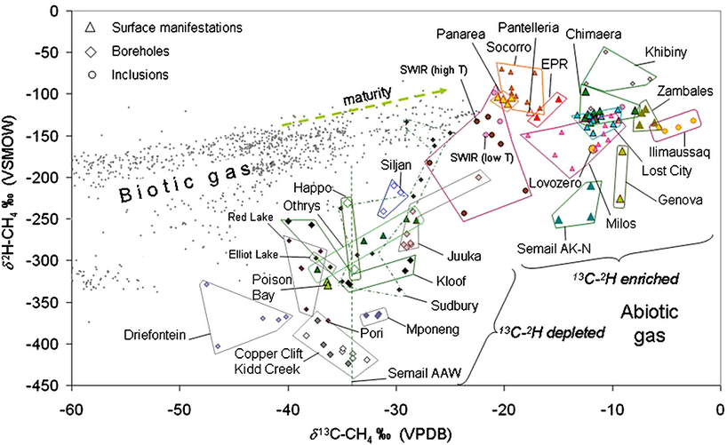
Values of δ¹³C vs δ²H for CH₄ gases which are considered to have a dominant abiotic component, from volcanic-hydrothermal systems little affected by organic matter in sediments (EPR: East Pacific Rise, SWIR: Southwest Indian Ridge; Socorro, Milos, Pantelleria, Panarea) (sediment-hosted hydrothermal fields, like Guaymas Basin and Salton Sea, are not considered), serpentinized ultramafic rocks (Chimaera-Turkey; Semail-Oman AK-N: Al-Khoud and Nizwa; AAW: Ain-Al-Waddah; Zambales-Philippines; Poison Bay-New Zealand; Othrys-Greece; Genova-Italy; Happo-Japan), and in submarine hydrothermal fields (Lost City); inclusions in igneous rocks in Russia and Greenland (Lovozero, Khibiny, Ilimaussaq); and from deep boreholes in crystalline igneous rocks in South Africa, Canada and Scandinavia (Sudbury, Juuka, Kloof, Mponeng, Pori, Copper Clift, Driefontein, Elliot Lake, Red Lake, Siljan Ring Gravberg-1 well). Data from: Abrajano et al. [1988], Botz et al. [1996], Boschetti et al. [2013], Etiope et al. [2011b, 2013b], Fritz et al. [1992], Kelley and Früh-Green [1999], Lyon and Giggenbach [1994], Potter et al. [2004], Proskurowski et al. [2008], Sherwood et al. [1988], Sherwood Lollar et al. [1993, 2006], Sano et al. [1993], Suda [2013], Taran et al. [2010a], Tassi et al. [2012], Welhan and Craig [1983], Whiticar [1990]. Small grey dots are from a global data set [Etiope et al., 2013a] of biotic (microbial and thermogenic) natural gases in sedimentary basin petroleum fields.
ABIOTIC METHANE ON EARTH
Authors
Giuseppe Etiope,
Barbara Sherwood Lollar
First published: April 2013

Slide 112
δ¹³C_{Input} + ∆¹³C_{Process} = δ¹³C_{output}
rearrange
∆¹³C_{Process} = δ¹³C_{output} - δ¹³C_{input}
∆¹³C_{Process}
δ¹³C_{Input} + ∆¹³C_{Process} = δ¹³C_{output}
Notes:
Problems with this kind of graph: relating single isotopic values to standards can’t tell you about a process.

